Slide 1





Slide 2






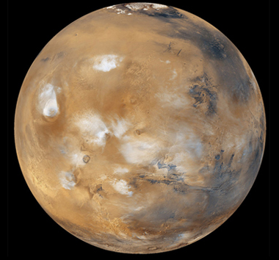

Remove the question mark to reveal the answer
NEXT
Photo courtesy of USDAgov (@flickr.com) - granted under creative commons licence - attribution

Slide 3



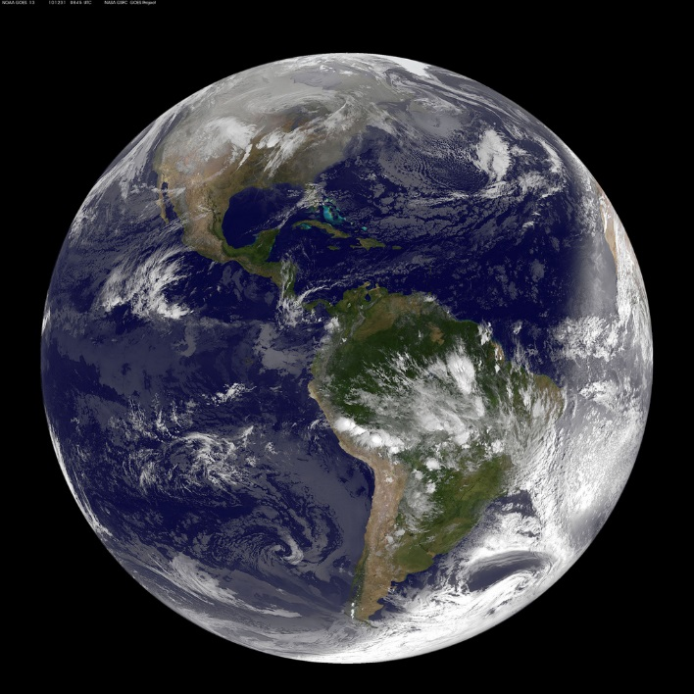

Remove the question mark to reveal the answer
NEXT
Photo courtesy of NASA Goddard Photo and Video (@flickr.com) - granted under creative commons licence - attribution

Slide 4

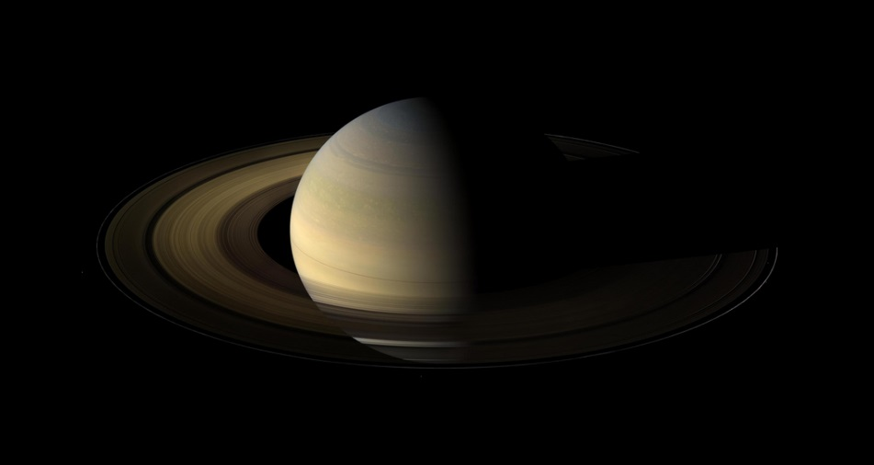

Remove the question mark to reveal the answer
NEXT
Photo courtesy of NASA Goddard Photo and Video (@flickr.com) - granted under creative commons licence - attribution

Slide 5


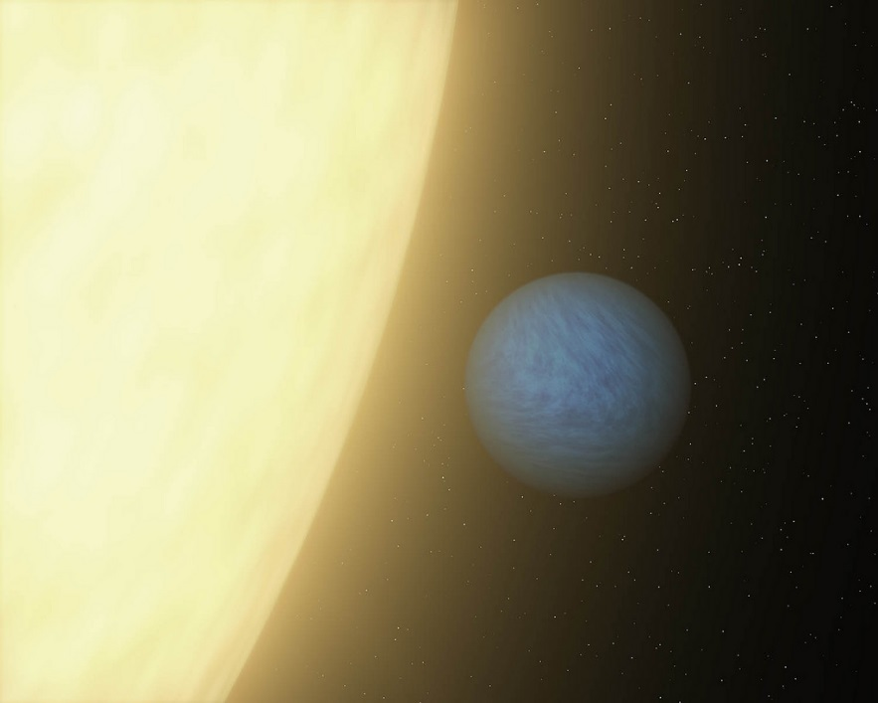

Remove the question mark to reveal the answer
NEXT
Photo courtesy of NASAblueshift (@flickr.com) - granted under creative commons licence - attribution

Slide 6
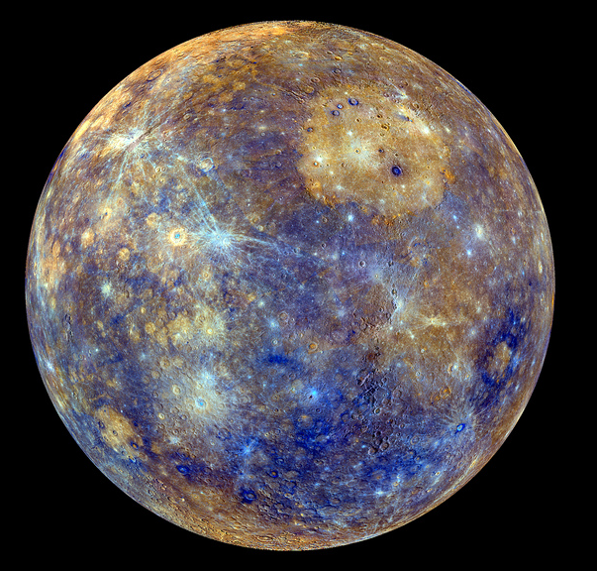

Remove the question mark to reveal the answer
NEXT
Photo courtesy of NASA Goddard Photo and Video (@flickr.com) - granted under creative commons licence - attribution

Slide 7


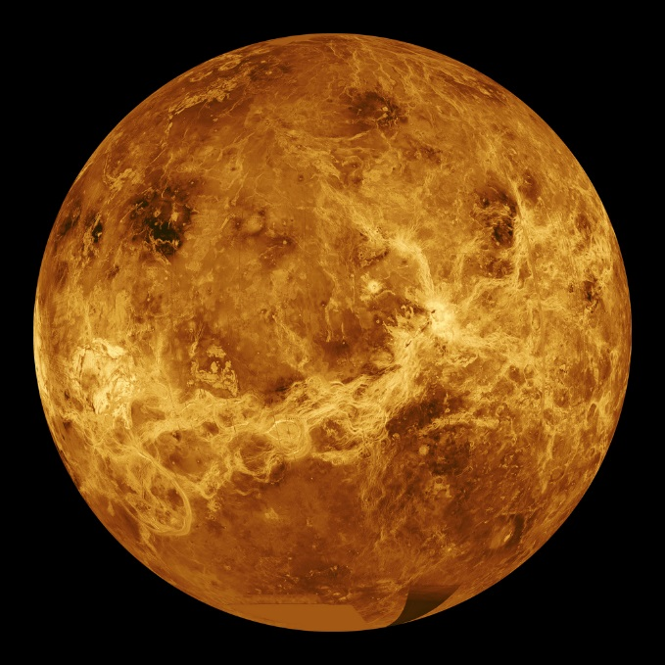

Remove the question mark to reveal the answer
NEXT
Photo courtesy of NASA Goddard Photo and Video (@flickr.com) - granted under creative commons licence - attribution

Slide 8



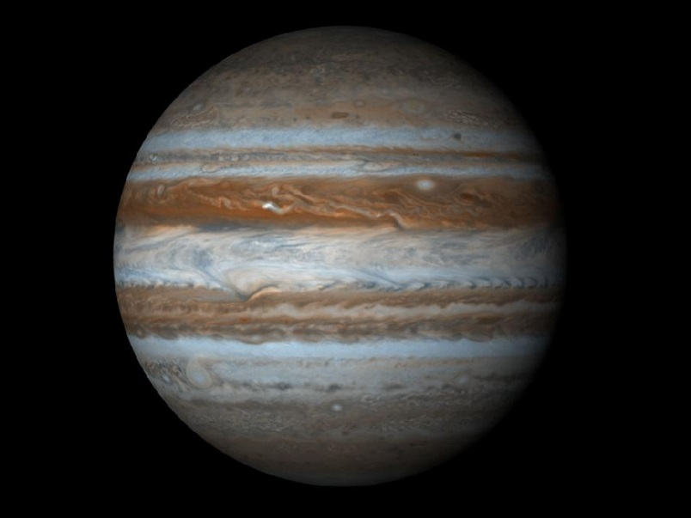

Remove the question mark to reveal the answer
NEXT
Photo courtesy of NASA Goddard Space Flight Center (@flickr.com) - granted under creative commons licence - attribution

Slide 9
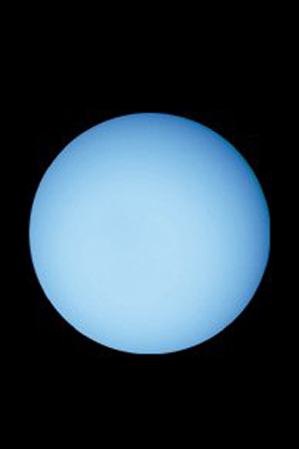

Remove the question mark to reveal the answer
NEXT
Photo courtesy of chrismeller (@flickr.com) - granted under creative commons licence - attribution

Slide 10

THE END

