Slide 1


Slide 2

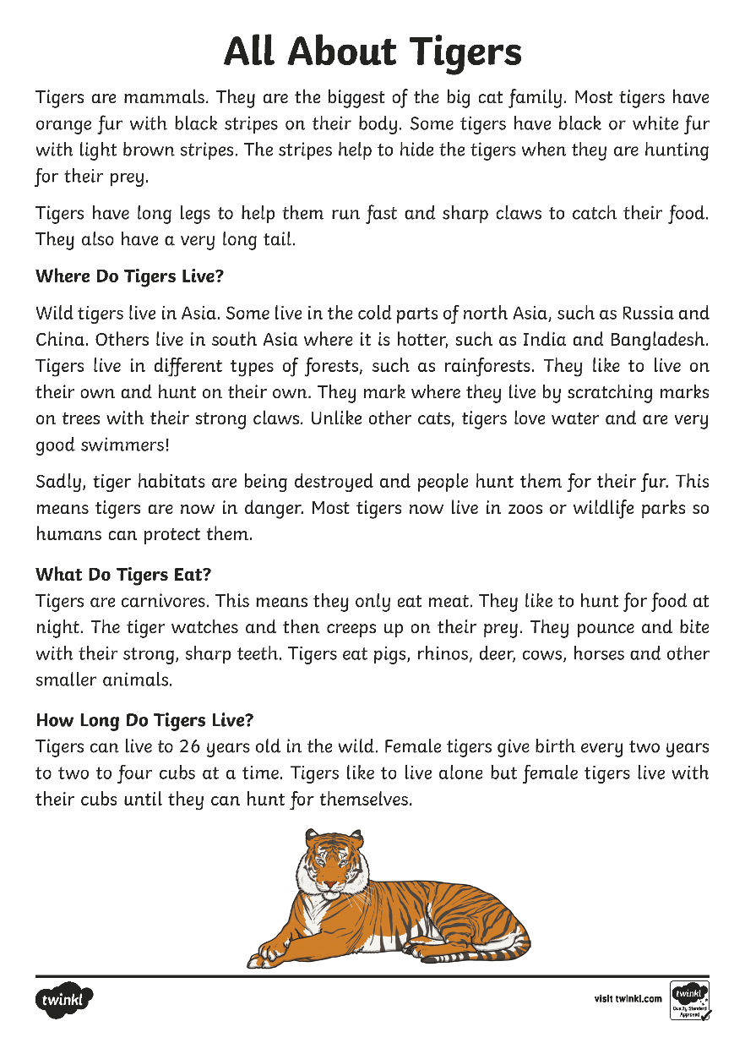

Slide 3
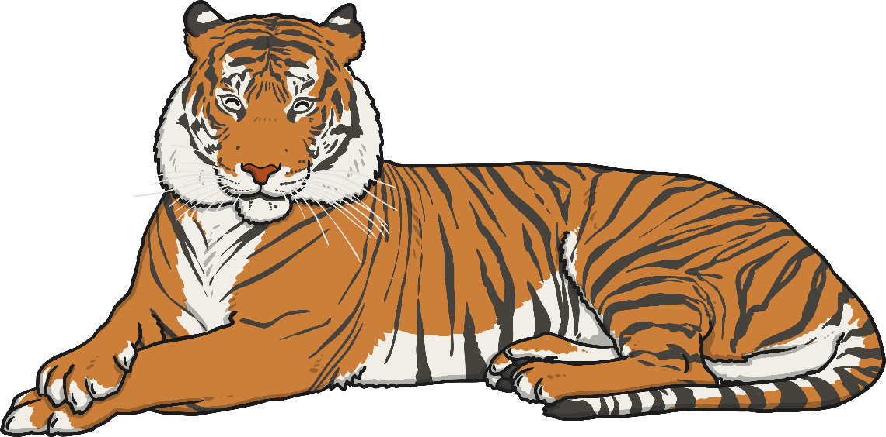
All About Tigers
Tigers are mammals. They are the biggest of the big cat family. Most tigers have orange fur with black stripes on their body. Some tigers have black or white fur with light brown stripes. The stripes help to hide the tigers when they are hunting for their prey.
Tigers have long legs to help them run fast and sharp claws to catch their food. They also have a very long tail.

Slide 4
Where Do Tigers Live?
Wild tigers live in Asia. Some live in the cold parts of north Asia, such as Russia and China. Others live in south Asia where it is hotter, such as India and Bangladesh. Tigers live in different types of forests, such as rainforests. They like to live on their own and hunt on their own. They mark where they live by scratching marks on trees with their strong claws. Unlike other cats, tigers love water and are very good swimmers!
Sadly, tiger habitats are being destroyed and people hunt them for their fur. This means tigers are now in danger. Most tigers now live in zoos or wildlife parks so humans can protect them.
What Do Tigers Eat?
Tigers are carnivores. This means they only eat meat. They like to hunt for food at night. The tiger watches and then creeps up on their prey. They pounce and bite with their strong, sharp teeth. Tigers eat pigs, rhinos, deer, cows, horses and other smaller animals.

Slide 5
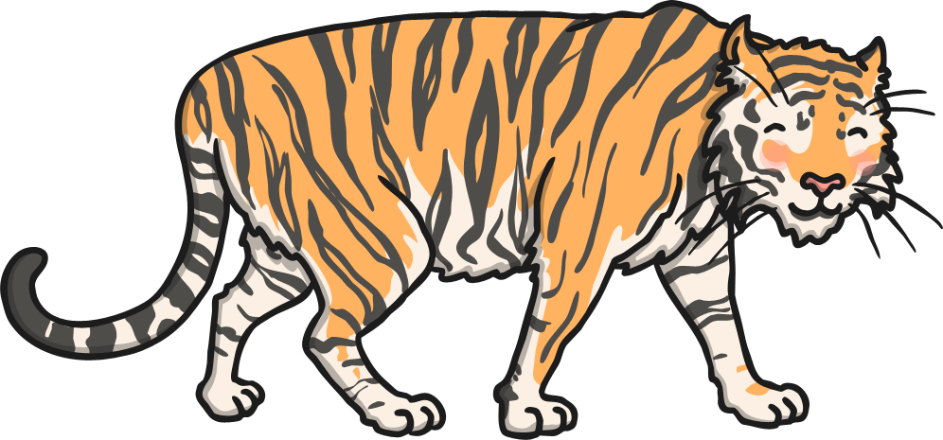
How Long Do Tigers Live?
Tigers can live to 26 years old in the wild. Female tigers give birth every two years to two to four cubs at a time. Tigers like to live alone but female tigers live with their cubs until they can hunt for themselves.

Slide 6


