Slide 2
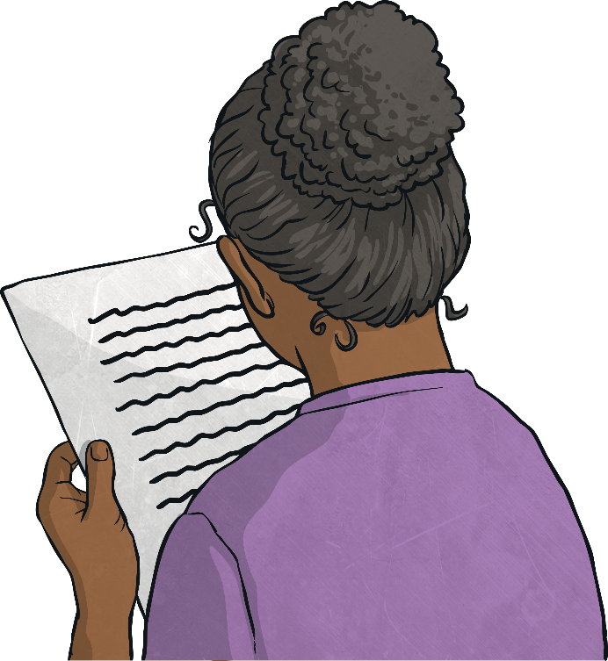
Poetry
Poetry is a form of literature and a very wide genre of writing. It is a form of imaginative writing that can be written by anybody. People choose to write poetry based on many different things. Expressing thoughts and feelings about something in a creative way is what poetry is all about.
The main aim of poetry is to involve and stimulate the thoughts of the reader. Poetry can connect with a reader on an emotional level too.
Poetry has many different forms, and can be written in many different ways. They can be short or long, fun or sad, real or imagined, structured or unstructured, rhyming or not. There is a lot of freedom when writing poetry and because of this, the writer is able to express their thoughts and feelings in very unique ways.

Slide 3
Poetry
There are many different types of poem including:
acrostic | sonnet | epic | blank verse
simile | colour | tetractys | pantoum
diamante | ballad | haiku | echo verse
limerick | renga | kenning | riddle
shape | cinquain | ode | free verse
tyburn | senryu | lyric | tanka

Slide 4
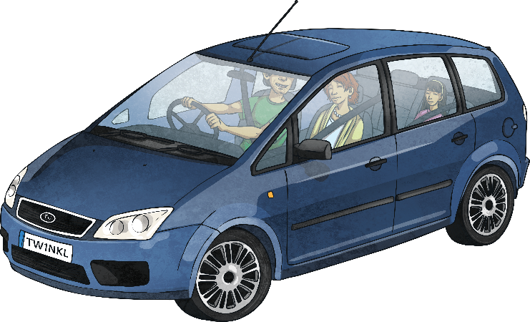
Adjective Poetry
Adjectives are describing words. They are used in poetry to create many different effects and visual pictures to the reader. The adjectives can be used for a more in-depth description of a noun, or they can be used to add more excitement and attention within a line or verse.
Some examples of couplets within poems:
Roaring roads,
Noisy cars,
Beaming headlights,
Tall streetlamps,
Dark, cold night.

Slide 5
Using Assonance
Assonance can also be identified as a ‘vowel rhyme’. It is when
a pattern or similar sounds within a poetry line are repeated.
Assonance is used in poetry in order to create many different effects. It creates a form of rhyme not just within a verse, but within a whole line.
An example of a prose poem:
I saw an iron ore next to the shore. (uses ‘aw’, ‘or’, and ‘ore’)
I said ‘Hey, I want the tray for Taylor the sailor’. (uses ‘ey’, ay’ and ‘ai’)
I see my mum when she sweeps and cleans the streets. (uses ‘ea’ and ‘ee’)

Slide 6
Couplet Poetry
A couplet is a pair of lines. These two lines typically rhyme together. They are also the same length due to same number of syllables present.
Couplets are used in poetry in order to create a rhyming flow.
Some examples of couplets within poems:
It’s hard to see the butterfly,
As it flies across the night sky.
I made the biscuits one by one,
I’m waiting for the bell, they’re done.
Lightning, thunder all around,
So much rains falls to the ground.

Slide 7
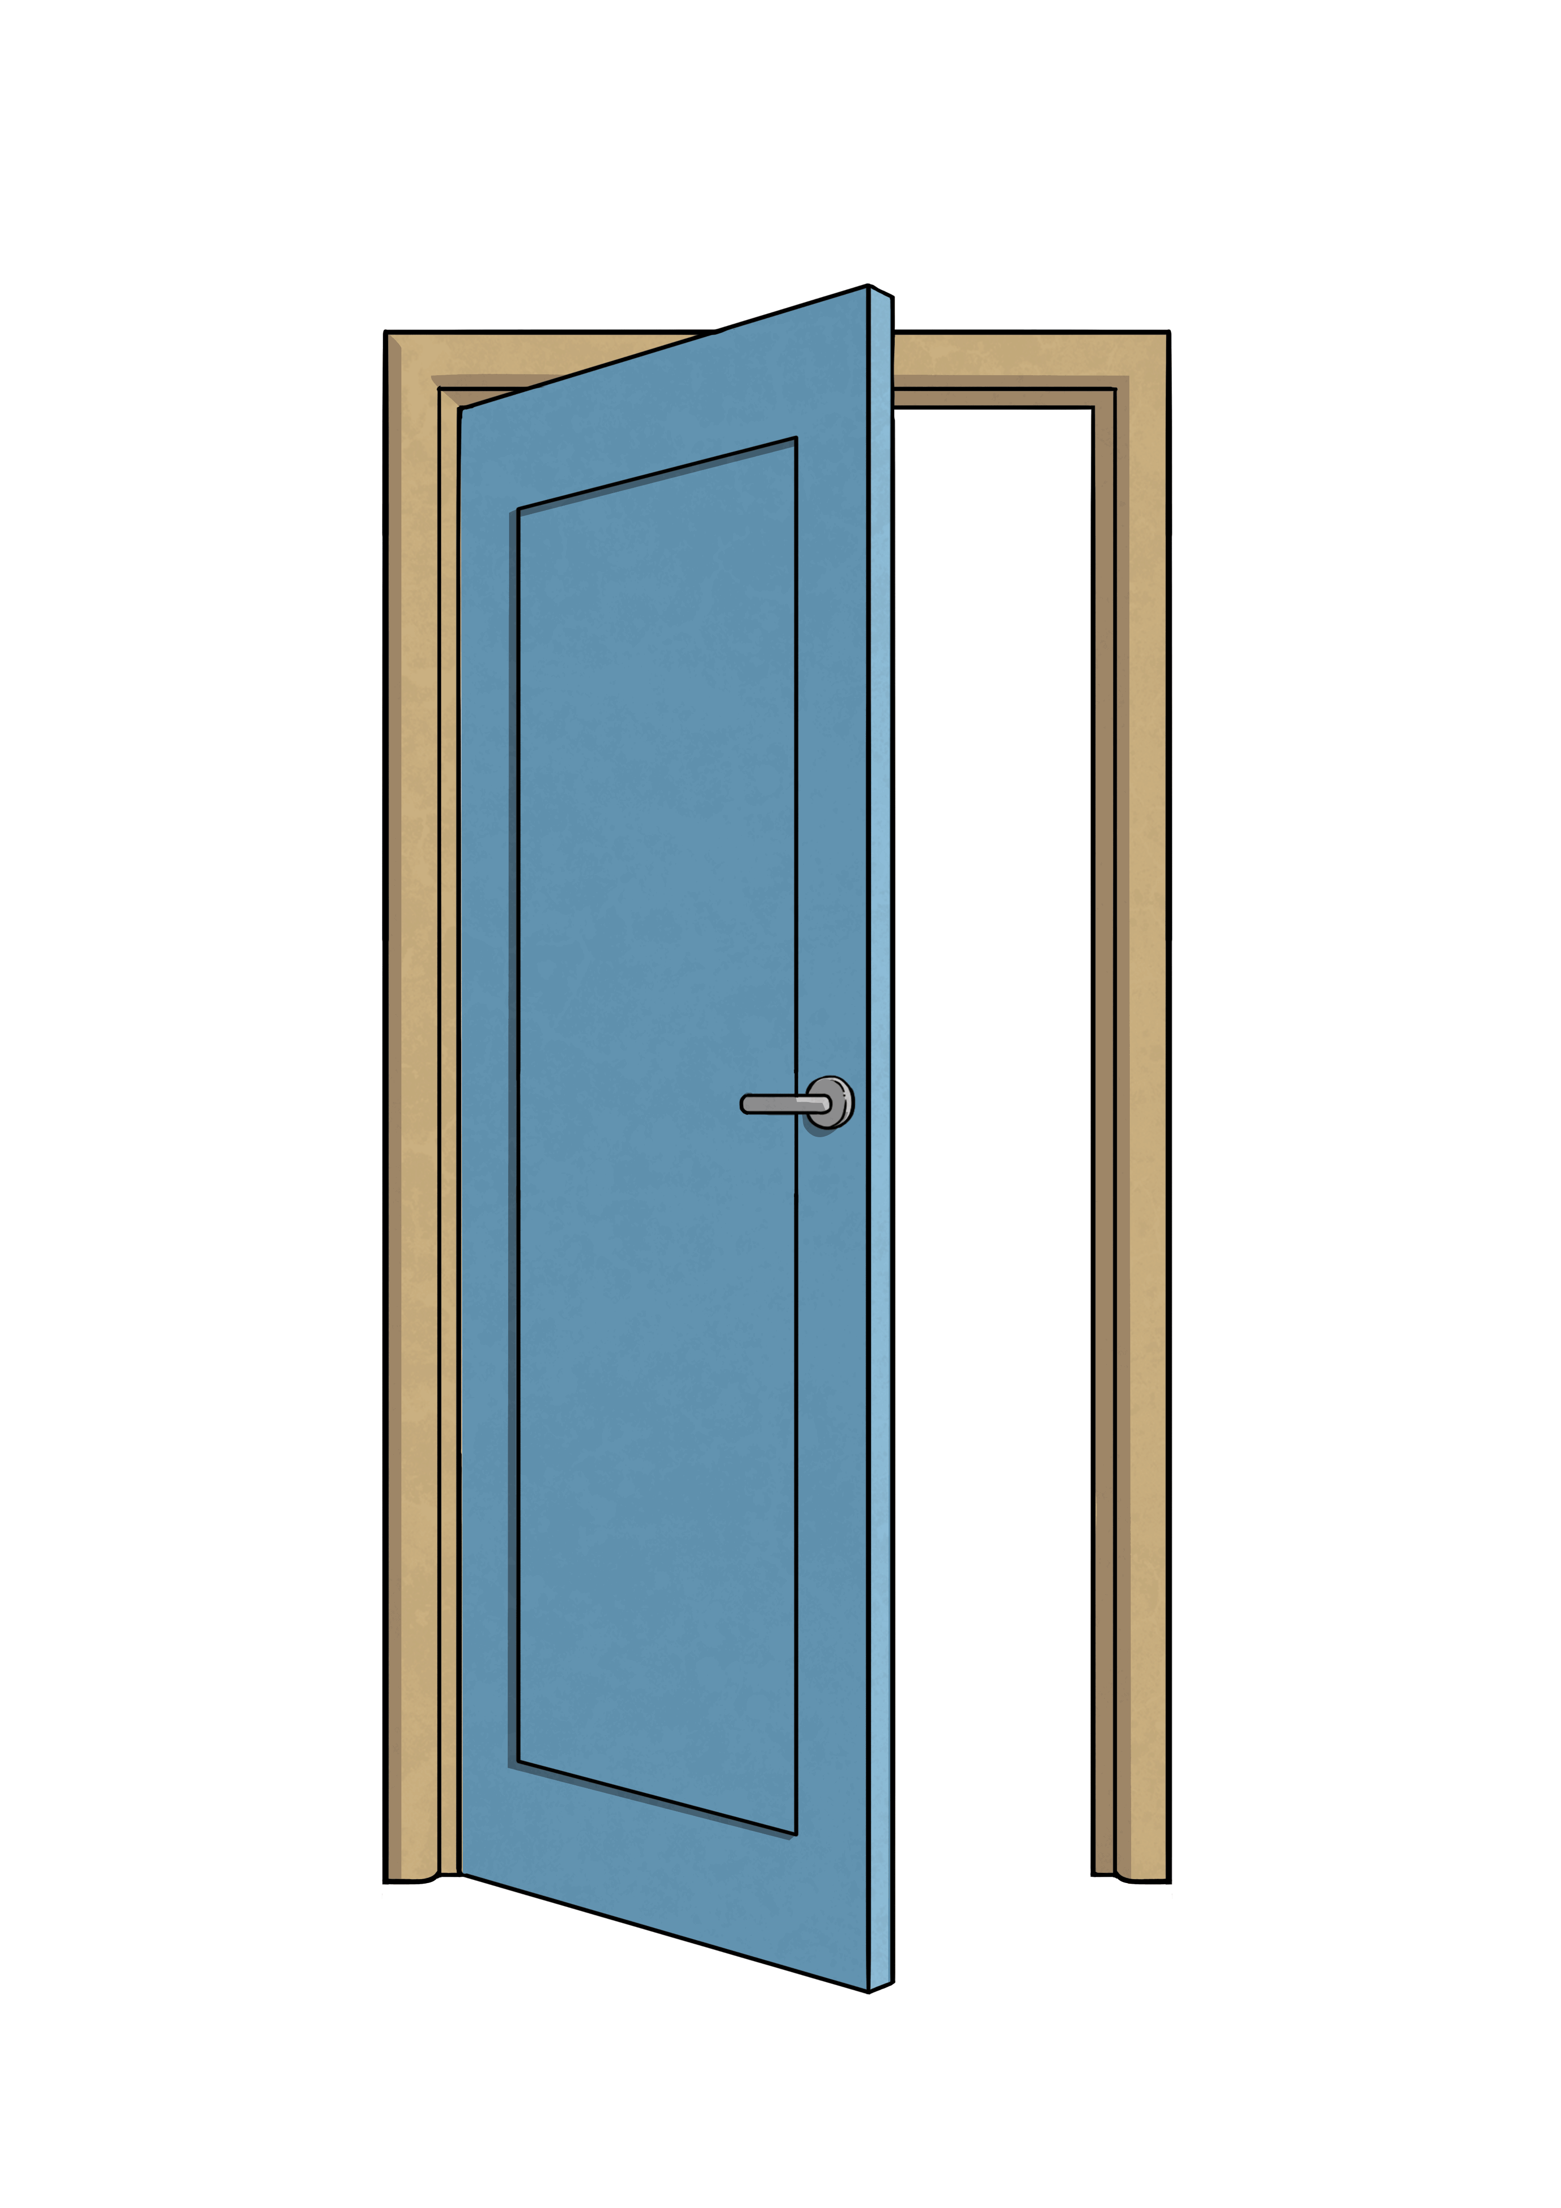
Using Onomatopoeia
Onomatopoeia is when a word imitates its natural sound,
or suggests the sound a certain object makes.
It is used in poetry to create a sound effect to make
the description more expressive and interesting.
Some examples of onomatopoeia:
bang
crash
pop
smash
drip
buzz
tick tock
whoosh
wham
pow

Slide 8
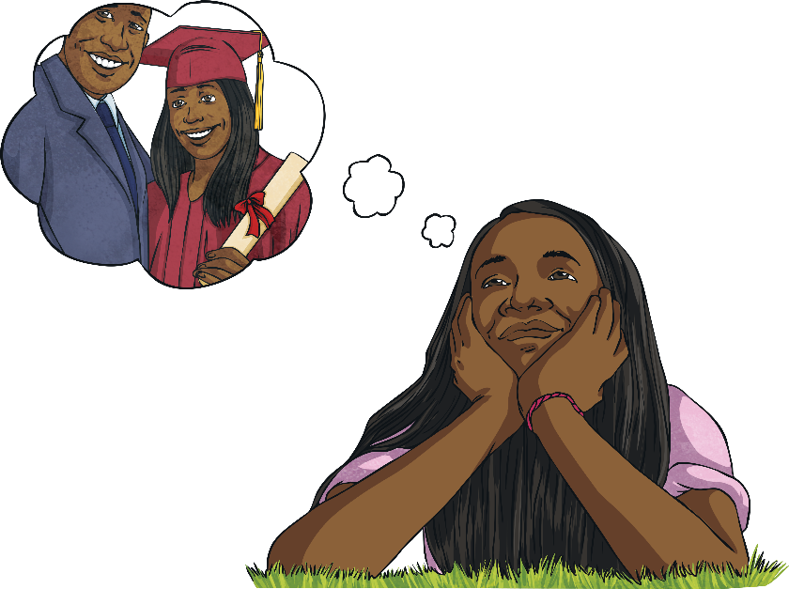
Prose Poetry
Prose is a form of language used in poetry that
has no formal structure and is written in paragraphs.
Prose does not relate to any form of rhymes or pattern.
It can contain language play, such as repetition.
An example of a prose poem:
Sometimes I daydream. Thoughts inside my head. Pictures in my mind.
Drifting off into my own world. My mind’s eye. Thoughts about my future.
Thoughts about my past. Thoughts about my present.
Until I wake up.

Slide 9
Using Repetition
Repetition is when a certain word, sentence or
phase is written more than once in a poem.
Repetition is used in poetry to help make the poem more
interesting, and to help create patterns. Depending on the word
or phrase that is repeated, repetition allows for more emphasis to be placed on certain themes, ideas or objects.
Some examples of where repetition can be used in poetry:
Using a refrain in a poem. This is where a verse or phrase is repeated during different stages of a song or poem.
Using a chorus in a poem. This is where a verse or phrase is repeated following each verse within a song or poem.
In an echo poem, the last word of each line can be repeated as a response in the next line.

Slide 10
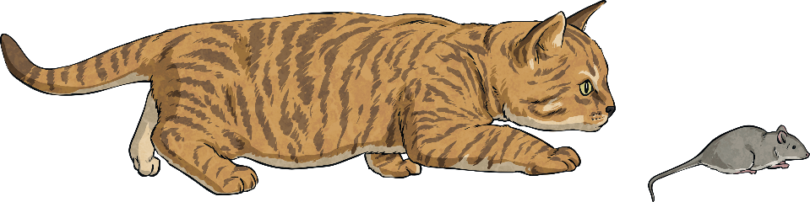
Using Syllables
A syllable is a unit of written or spoken words.
Syllables are broken up sounds that are used to create words.
One syllable = monosyllabic
More than one syllable = polysyllabic
Syllables are used in poetry to create rhythm.
Look at the syllable pattern in this poem:
Cat, (1)
Fluffy, (2)
Catches mice, (3)
My faithful pet. (4)

Slide 11
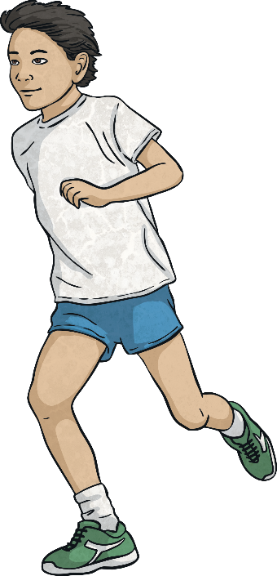
Verb
Verbs are doing words. They show actions within a sentence.
Verbs are used in poetry to create a range of effects. They are used to create more interesting sentences, and to help describe what different people and objects are doing.
Some examples of verbs:
The boy ran along the shoreline.
The women held her baby tightly.
It followed her to school one day.

Slide 12
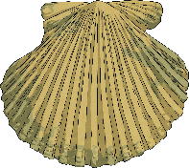
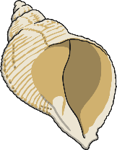
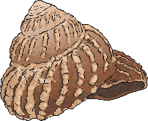

Alliteration
Alliteration is when the sound or letter at the beginning of each or most of the words in a sentence is the same.
Alliteration is used in poetry to create many different effects.
It can be used to create a greater and more interesting description
of different themes, people and objects.
Some examples of alliteration:
Sally sells sea shells by the sea shore.
All authors allow authority after midnight.
Theresa tripped and tumbled tremendously over the tree.

Slide 13
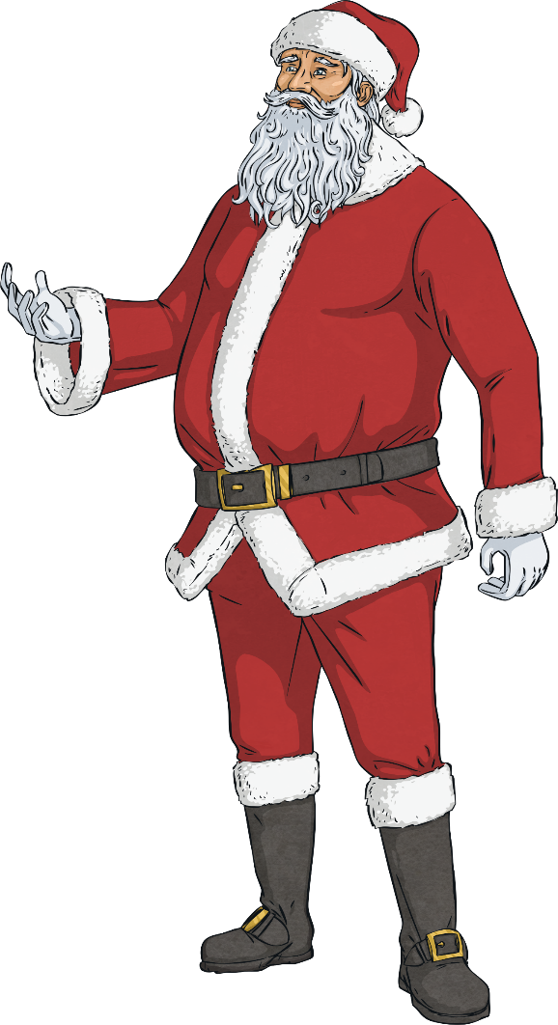
Chorus
A chorus is the part of a song or poem that is repeated after verses.
A chorus is used in poetry to create more drama around and emphasis
of a particular idea or theme.
Some examples of choruses:
We wish you a Merry Christmas,
We wish you a Merry Christmas,
We wish you a Merry Christmas,
And a happy New Year!
Glad tidings we bring,
To you and your kin;
Glad tidings for Christmas
And a happy New Year!
We wish you a Merry Christmas,
We wish you a Merry Christmas,
We wish you a Merry Christmas,
And a happy New Year!

Slide 14
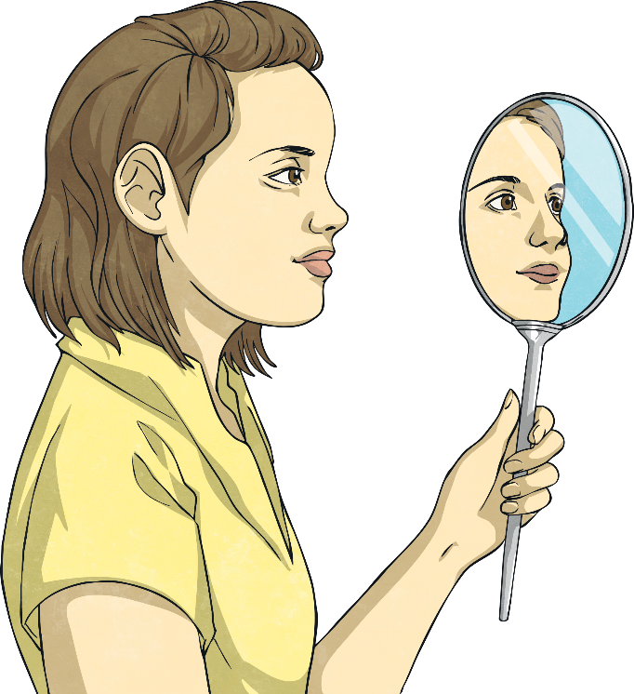
Oxymoron
Oxymoron is a figure of speech that uses different or opposing terms. The most common form of oxymoron involves just two words.
Oxymoron is used in poetry to create dramatic expression and effect.
Some examples of oxymoron:
Bitter sweet
Pretty ugly
Act natural
Seriously funny
Passive aggressive
Alone together
Deafening silence
Living dead

Slide 15
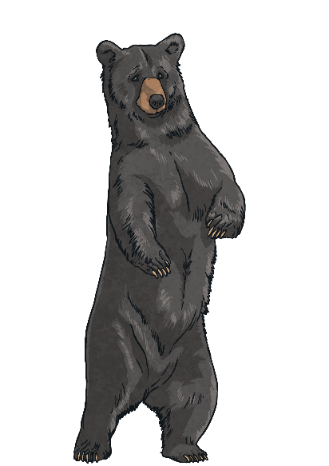
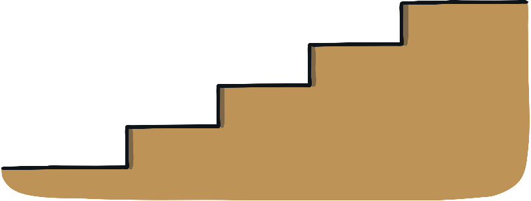
Rhyme
Rhyme occurs when two words sound the same when spoken out loud. These words usually have the same ending sounds,
however they don’t need to be spelt the same.
Rhyme is used in poetry to create something interesting to read.
It is used to create a pattern within a poem.
Some examples of rhyme:
Fright and night
Would hood
Should could
Hail and pale
Male and stale
Air and fare
Two and do
Day and sway
Pause and claws
Bears and stairs

Slide 16

Simile
A simile is a figure of speech. It is when one thing
is compared to another using the words ‘like’ or ‘as’.
Similes can be as descriptive as the writer chooses.
Similes are used in poetry to give the reader a more descriptive and
in-depth understanding about a particular object or person.
Some examples of simile:
As busy as a bee – This is comparing someone’s level of energy to the speed of a bee.
As snug as a bug in a rug – This is comparing someone who is very cosy to how comfortable a bug would be in a rug.
Runs like a cheetah – This is comparing the speed that someone can run to the speed of a cheetah which is quite fast.
As white as a ghost – This is comparing a person’s skin colour to a ghost, usually because they are frightened, sick or scared of something.

Slide 17
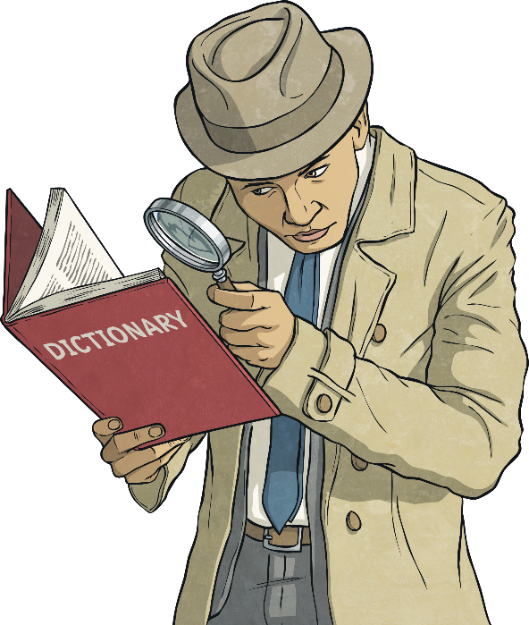
Synonym
A synonym is a word that has the same, or similar, meaning
as another word. Synonyms can be found in a thesaurus.
Synonyms are used in poetry to be more graphic
and to give a broader description.
Some examples of synonyms:
Beautiful – attractive, pretty, gorgeous, stunning
Funny – hysterical, humorous, amusing, entertaining
Student – pupil, scholar, schoolboy, schoolgirl
Lazy – idle, sluggish, indolent, slothful

Slide 18
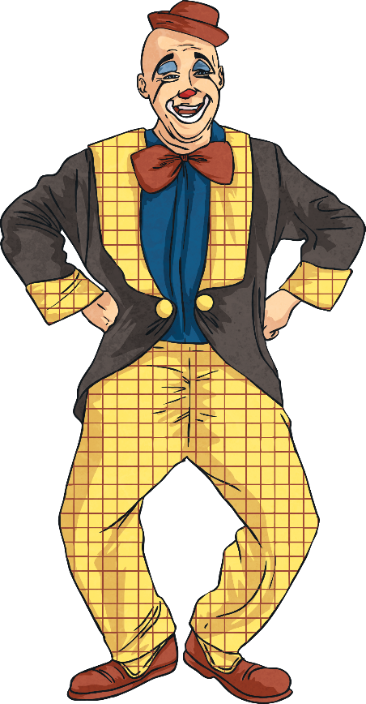
Consonance
Consonance occurs when a consonant, or a consonant pattern
is repeated two or more times in a short space of writing.
Consonance is used in poetry to create a range of different rhyming effects. It also makes it more enjoyable and interesting to the reader.
Some examples of consonance:
Pitter-patter, pitter-patter. (Using the ‘tt’ and ‘er’ letter patterns).
Jeremy juggled jig-saw puzzles. (Using the letter j).
Toss the glass across the grass. (Using the ‘ss’ letter pattern).
Dawn goes down with a big frown unlike the clown.
(Using the ‘wn’ letter pattern).

Slide 19
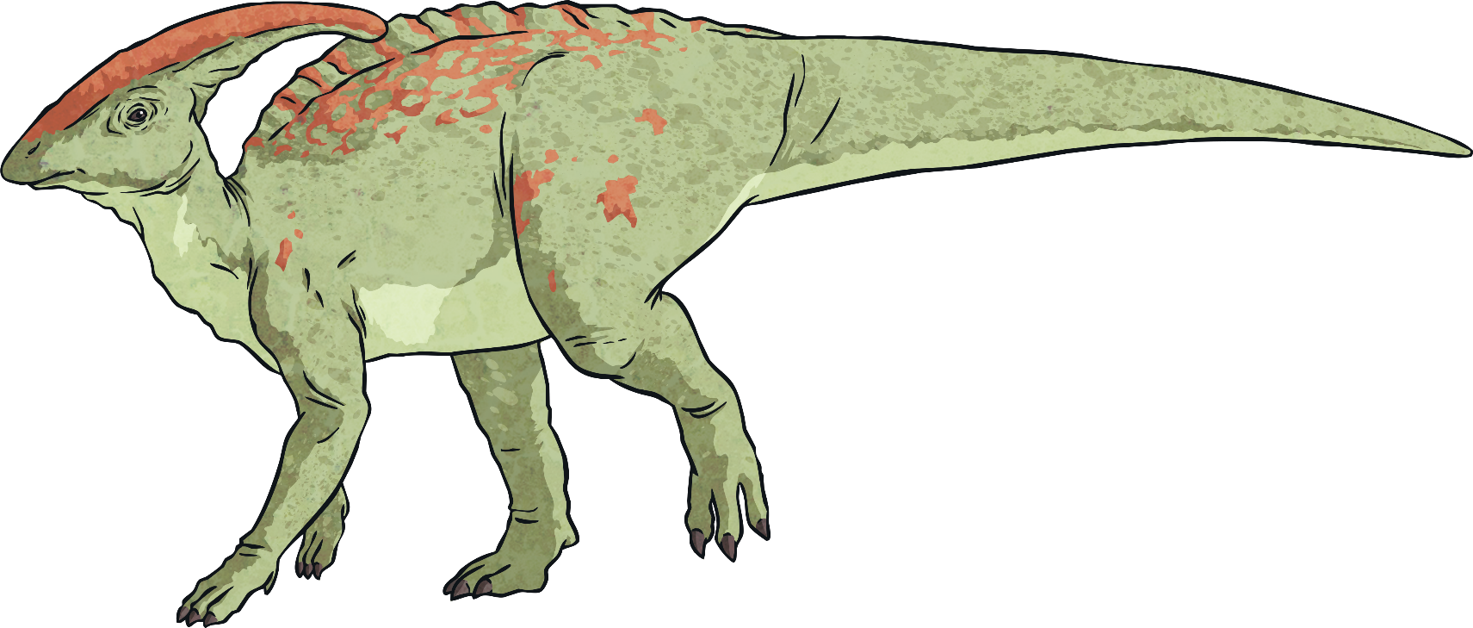
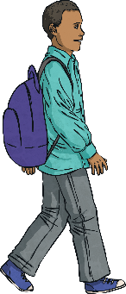
Hyperbole
Hyperbole is a figure of speech which involves an exaggeration of an idea.
Hyperbole is used in poetry to provide strong
effects and to provide great emphasis.
Some examples of hyperbole:
I’m so hungry that I could eat a horse.
It was so cold that I saw polar bears wearing jackets.
I had a million things to do.
That joke is so old, the last time I heard it
I was walking next to a dinosaur.

Slide 20
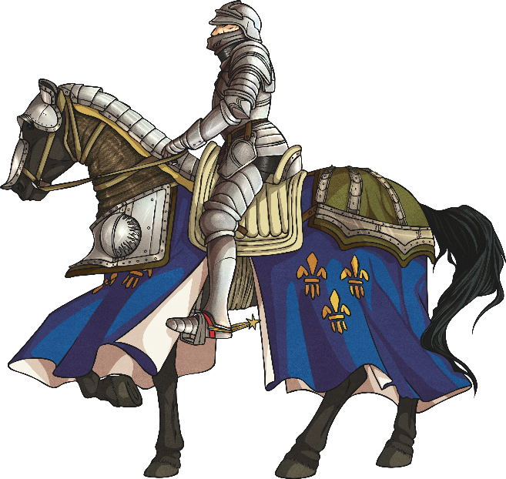
Metaphor
A metaphor is a figure of speech which describes a place,
object or subject as something unlikely and uncommon.
Metaphors are used in poetry to create an image of
judgement and comparison in the mind of the reader.
Some examples of metaphor:
Her eyes were glistening jewels.
She is the sunshine which brightens up our day.
The kids at school are all brains.
In Andrew’s eyes, Rebecca is the sun.
He is my knight in shining armour.
The world is a stage.

Slide 21
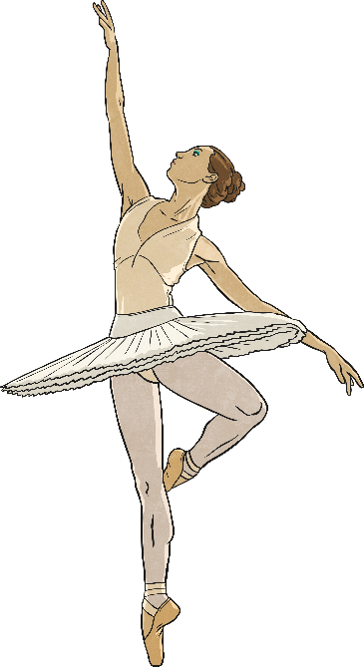
Stanza
A stanza is a group of lines gathered together by rhythmical pattern and meter. A stanza with four or more lines can be referred to as a verse. The length and pattern of a stanza decides what type of poem it is. Stanzas are made by leaving a blank space before and after it.
Two lines = Couplet
Three lines = Tercet
Four lines = Quatrain
Five lines = Cinquain
Stanzas are used in poetry to provide structure and form.
Some examples of stanzas:
I love to dance,
I love to prance.
What my heart would do,
But be sad and blue,
If I could not dance.
First Stanza
Dancing feels nice,
But it come at a price.
Dancing tutus and shoes
My gosh you can’t lose!
Second Stanza

Slide 22
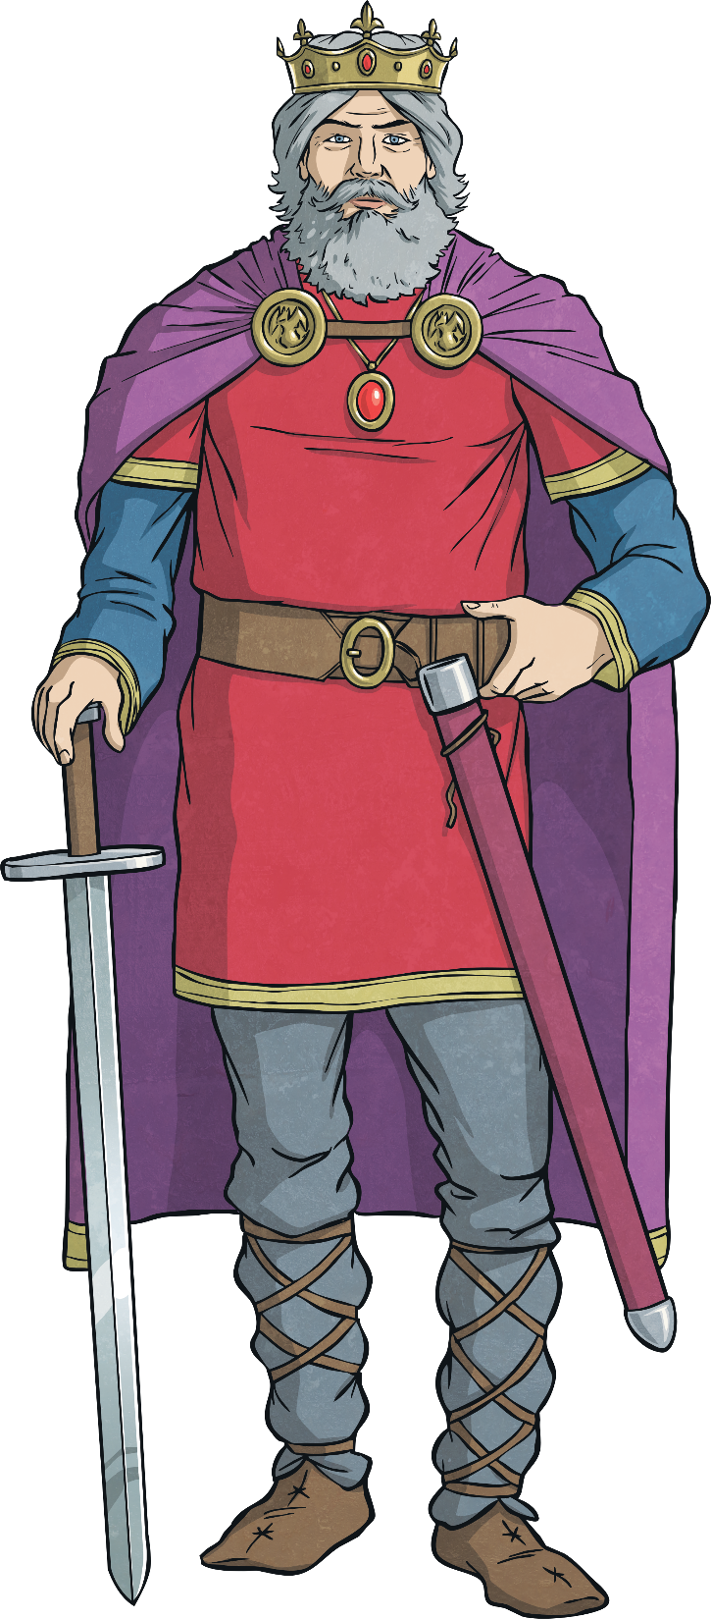
Rhymed Verse
Poetry written in a metrical form that rhymes throughout.
An example of rhymed verse:
I hear the people sing,
To the glory of the king.
He sits up on his great big chair,
To watch everybody just sit and stare.
This poem has four lines.

Slide 23
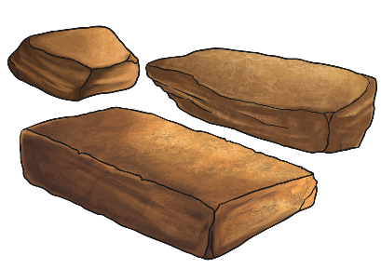
Blank Verse
Poetry written in regular, metrical, but unrhymed lines.
An example of blank verse:
Something there is that doesn’t love a wall.
That sends the frozen-ground swell under it,
And spills the upper boulders in the sun;
-Mending Walls by Robert Frost
This poem has three lines.

Slide 24
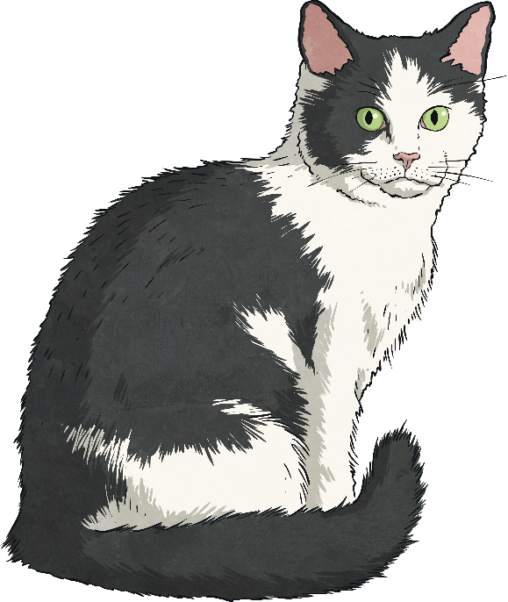
Free Verse
Poetry written with no fixed meter and no end rhyme. Free verse may include end rhyme, but it most commonly does not.
An example of free verse:
There once was a
cat who
sat down on the
mat
and stayed there till
morning tea
time.
This poem has seven lines.

