Slide 1
King’s Court First School
Caring, Sharing and Learning Together
Y1 Phonic Screening Presentation 2021

Slide 2
The Phonic Screening Check
The purpose of today’s meeting is to share:
The who, what, when, why’s and how’s.

Slide 3
The Phonic Screening check
The phonics screening check that is taken nationally by all children in Y1 and some children in Y2.
Usually takes place in June.
It is designed to give teachers and parents information on how your child is progressing in phonics.
It will help to identify whether your child needs additional support at this stage so that they do not fall behind in this vital early reading skill.

Slide 4
What is the phonic screening check?
There are two sections in this 40-word check and it assesses phonics skills and knowledge learned through Reception and Year 1. Your child will read up to four words per page
This generally take between 5- 10 minutes.

Slide 5
Why does my child do the phonic screening check?
It checks that your child can:
Sound out and blend graphemes in order to read simple words.
Read phonically decodable one-syllable and two-syllable words, e.g. sand, windmill.
Read a selection of nonsense words.

Slide 6
Why nonsense words?
These are words that are phonically decodable but are not actual words e.g. brip, snorb.
To check whether your child can decode a word using phonics skills and not their memory.
Shown to your child with a picture of a monster- so they will know it is a nonsense word.

Slide 7
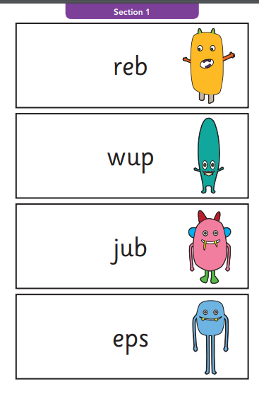
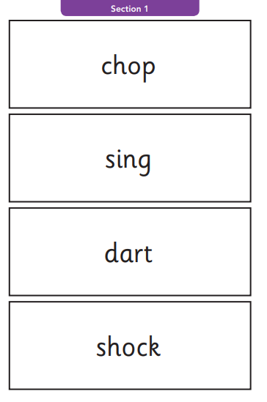
What does it look like?

Slide 8
Who, where and how will it take place?
Individually with Miss Brooker or Mrs Pye- Beraet
In a quiet space within school
Sit down together and be shown 4 words at a time that your child will decode and their answered is recorded by an adult.

Slide 9
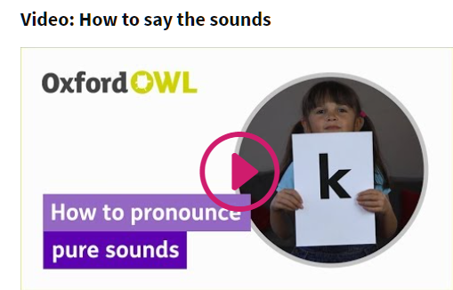
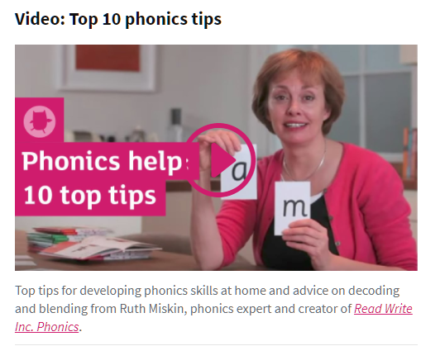
How can I support my child?
Ask your child to spot digraphs/trigraphs everywhere- supermarkets, at the park, road signs, magazines etc.
Play games such as snap, pairs, hiding words around the house for your child to read.
Reading everyday.
https://home.oxfordowl.co.uk/reading/learn-to-read-phonics/

Slide 10

Children’s activity
Thank you for joining us today
I hope you have found this informative.
We will be around now during the book look if you have any questions.
Also we would love it, if you have a second to complete our Ofsted parent view survey

