Slide 2


What Is a Diary Entry?
Oops Dragon
A diary entry is when you write about a day in the life of a real person or character.
A diary entry needs to be exciting for the reader and keep their interest.
The diary is personal. It needs to sound like the person, or character, has written it. It is written from their point of view.
Think About It
Do you know anyone who writes a diary?
Do you ever stop and think about the day you have just had?

Slide 3


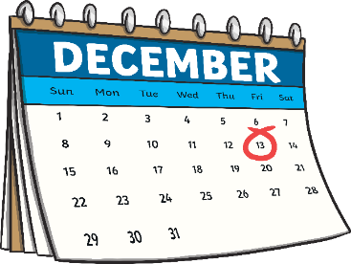


Writing a Diary
Oops Dragon
Include the date and/or time.
You can add the date or the time at the top of the page like this…
Or, you can include it in the diary entry like this…
Monday 2nd December 2019
Dear diary,
Today, I was woken up at 6 o’clock by my screaming baby brother. I felt cross as it wasn’t time to get up, but when I looked out of the window the feeling of anger disappeared… the ground was covered in snow! Mum shouted up to tell me that there was no school and it has been cancelled.
Dear diary,
It was an eventful start to the month of December today. I have been looking forward to today for such a long time, and it was always meant to be eventful, but just not quite in that way!

Slide 4
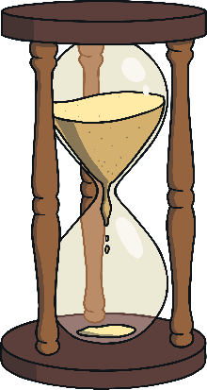

Writing a Diary
Oops Dragon
Write in the past tense.
A diary is always written in the past tense.
This is because the events have already happened.
Which sentence has been written in the past tense and would be the best diary entry?
Answers
It has been such an exciting day!
There were so many wonderful stalls to see at the Christmas market…
It is such an exciting day! There are so many wonderful stalls to see at the Christmas market...
It has been such an exciting day!
There were so many wonderful stalls to see at the Christmas market…

Slide 5

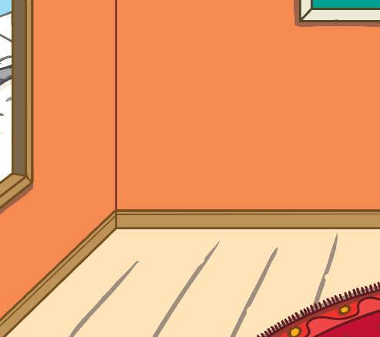


Writing a Diary
Oops Dragon
Include the words ‘I’, ‘my’, ‘we’ and ‘our’.
A diary needs to sound like it is being written by a person who is talking about themselves.
This type of writing is called ‘first person’.
Look at these sentences. Which one is written in ‘first person’?
Click on the sentence to reveal the answer!
First person!
I visited the cafe with my grandparents. I ordered a hot chocolate and we shared a slice of carrot cake.
He visited the cafe with his grandparents. He ordered a hot chocolate and they shared a slice of carrot cake.
Not first person!

Slide 6



Writing a Diary
Oops Dragon
Write as if you were there.
When we read a diary we should feel as though we were really there.
This can be done by adding lots of detail and description to a diary entry.
Read this sentence. Can you spot the extra detail and description that has been added to make it sound like the writer was really there?
Answers
The sparkly, shiny Christmas tree was about to be lit up when the clock stuck 6. I saw some very excitable, young children who came from the small, pretty row of cottages and we waited for the beautiful, colourful lights to be switched on.

Slide 7

Writing a Diary
Oops Dragon
Answers
Put the most important events in order.
In a diary, the events of the day are usually written in the order that they happened. This means that a diary entry starts with waking up and finishes with the end of our day.
Only the most important or interesting events are included.
Read these sentences. Can you put them in the correct order for a diary entry?
I was so tired that I only managed one page of my book at bedtime.
I had lunch with my friends at school and I tried lasagne for the first time, it was delicious!
It was 5 o’clock in the morning when the birds woke me.
After school, Sophie’s mummy picked us both up and we all went
ice skating.

Slide 8


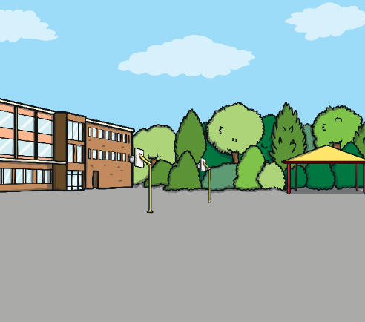

Writing a Diary
Oops Dragon
Describe feelings.
A diary is a secret place to write about your day and how you feel about it.
Your diary may record your hopes, fears, dreams and feelings that you may not want anyone to know about.
Read these sentences below. Can you spot where the writer has described their feelings?
Answers
Answers
I couldn’t wait to see my friends on the playground so I ran ahead of the rest of the class. I nearly reached my friends when Mr Lilly shouted my name across the crowd. My cheeks started to burn, but I tried not to let my embarrassment show.
It was just before 6 o’clock and we had been waiting for a long time to see the Christmas tree lights get switched on. When they were finally switched on, I could feel my legs tingling and my face burst into a smile all by itself.

Slide 9

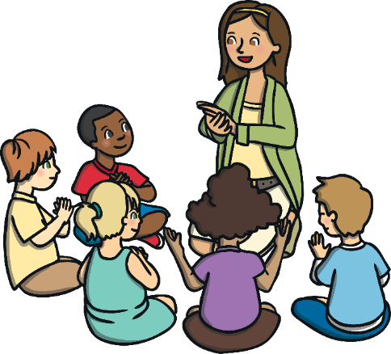
Writing a Diary
Oops Dragon
Use time linking words, e.g. ‘next’, ‘first, and ‘then’.
A diary describes lots of events. To explain when these events happened, it is really useful to include time linking words, such as ‘next’, ‘first’, and ‘then’. We could link the events with just one word, such as ‘and’, but it wouldn’t be very interesting.
Read the sentences below. Can you add different time words to the start of each sentence to make the diary entry more interesting to read?
Answers
I got out of bed. I made sure that I had a really good breakfast of porridge. We walked the long way to school to post a letter. The teacher announced that we were going on a school trip!
First,
Next,
Then,
After that,

Slide 10

Writing a Diary
Oops Dragon
Talk about where events happened.
Diary entries tell us when events take place, but they also need to help the reader and explain where they took place.
This can be done by adding the name of the country, town, room or building where events happen.
Read this example. Can you think of some ideas to help the reader understand where the events took place?
Answers
This morning I got on the train
. I had my lunch on the train
. I travelled nearly four hours until I arrived . When I arrived I could see my grandad waiting for me .
at Waterloo
in the cabin
in Devon
on the platform

Slide 11










Include the date and/or time.
Write in the past tense
Include the words ‘I’, ‘my’, ‘we’ and ‘our’.
Write as if you were there.
Put the most important events in order.
Describe feelings.
Use time linking words, e.g.’next’, ‘first, and ‘then’.
Talk about where events happened.

