Slide 1
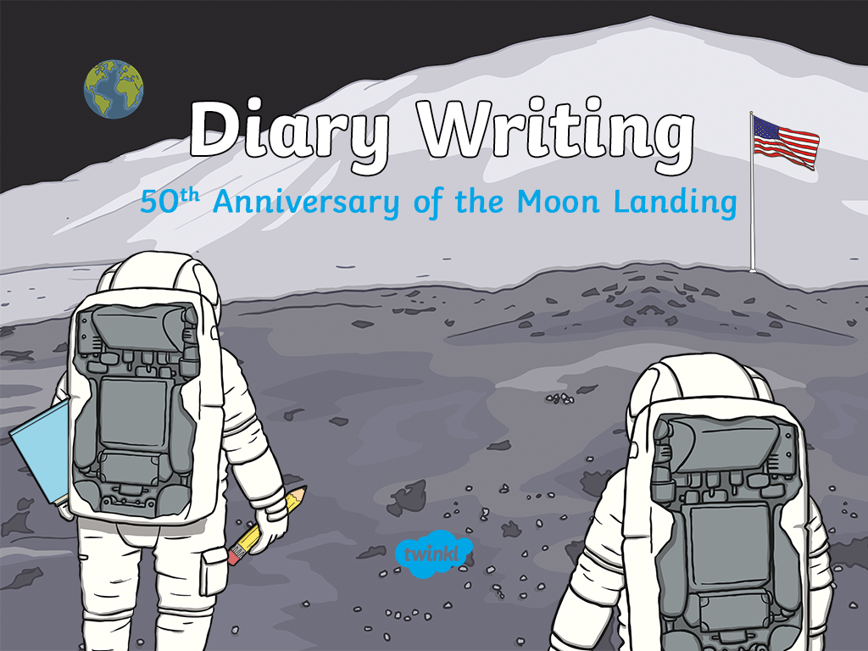

Slide 2
Did You Know…?
The first successful Moon landing took place 50 years ago on the 20th July 1969.
Three astronauts were part of that first successful mission: Neil Armstrong (38),Buzz Aldrin (39)
and Michael Collins (38).
The spacecraft they flew to the Moon in was called Apollo 11. It took them three days to get there (76 hours) and they travelled 240,000 miles.
NASA (the US Space Agency) still have the original audio recordings from the mission. Click on the button to hear the actual Apollo 11 take off.
Listen
Notes:
We hope you find the information on our website and resources useful. This resource contains links to external websites. Please be aware that the inclusion of any link in this resource should not be taken as an endorsement of any kind by Twinkl of the linked website or any association with its operators. You should also be aware that we have no control over the availability of the linked pages. If the link is not working, please let us know by contacting TwinklCares and we will try to fix it although we can assume no responsibility if this is the case. We are not responsible for the content of external sites.

Slide 3
Did You Know…?
Neil Armstrong and Buzz Aldrin took the lunar module named The Eagle down to the Moon’s surface.
It was not easy to find a suitable place to land on the
Moon. The Eagle was running out of fuel and only had a
couple of minutes left by the time it actually touched down.
Only two of the three astronauts on the mission
actually landed on the Moon. Michael Collins was
the unlucky astronaut who had to stay behind on
the command module. Click on the button to hear
the actual landing on the Moon.
Listen
Notes:
We hope you find the information on our website and resources useful. This resource contains links to external websites. Please be aware that the inclusion of any link in this resource should not be taken as an endorsement of any kind by Twinkl of the linked website or any association with its operators. You should also be aware that we have no control over the availability of the linked pages. If the link is not working, please let us know by contacting TwinklCares and we will try to fix it although we can assume no responsibility if this is the case. We are not responsible for the content of external sites.

Slide 4
Did You Know…?
Neil Armstrong was the first man to actually walk on the Moon. As he stepped onto the Moon, Armstrong said, “That
is one small step for man, one giant leap for mankind.”
Buzz Aldrin also joined Armstrong to walk on the Moon.
They spent two hours on the surface collecting
samples and information.
They put an American flag on the Moon to show they
represented the first country to land there. The astronauts
also spoke to the US president during their time on the Moon. Click on the button to hear Neil Armstrong's first words
on the Moon.
Listen
Notes:
We hope you find the information on our website and resources useful. This resource contains links to external websites. Please be aware that the inclusion of any link in this resource should not be taken as an endorsement of any kind by Twinkl of the linked website or any association with its operators. You should also be aware that we have no control over the availability of the linked pages. If the link is not working, please let us know by contacting TwinklCares and we will try to fix it although we can assume no responsibility if this is the case. We are not responsible for the content of external sites.

Slide 5

The First Men on the Moon
The video below shows some of the original footage the people would have seen in July 1969.
The first Moon landing was watched on television by over 600 million people across the world.
Notes:
We hope you find the information on our website and resources useful. This resource contains links to external video websites. These websites often have autoplay features meaning that other videos will play after the video you are watching finishes. You should disable this feature before using the video in any classroom or similar setting. Twinkl assumes no responsibility for the contents of linked websites. The inclusion of any link in this resource should not be taken as an endorsement of any kind by Twinkl of the linked website or any association with its operators. We have no control over the availability of the linked pages. If the link is not working, please let us know by contacting TwinklCares and we will try to fix it, although we can assume no responsibility if this is the case.

Slide 6
Diary Writing
On the day of the Moon landing, over 600 million people across the world watched the events on their televisions. It was such an exciting moment in history that everyone wanted to watch.
Imagine you were a child in 1969 watching the landing on your TV. Write a diary entry to describe the events of the first Moon landing.
Click on the following slides to learn about features of diaries that you will need to include in your writing.
Next

Slide 7
Using the Words: I, My, We, Our
These words are special because they tell us a diary is being
written by someone and they are talking about themselves.
We say this is writing in the first person.
Look at these two examples.
Which one uses the correct words for the first person?
First Person!
Not first Person!
Example A
Example B
I saw Apollo 11 take off for space. We watched it all on our neighbours’ television set.
My brother fell asleep.
At school, she watched the first man walk on the Moon.
When her mum collected her, they decided they would not like to go to the Moon.
Answers

Slide 8
Putting the Events in Order
Put these events from the Apollo 11 mission in the correct order.
The astronauts left an American flag on the Moon.
Apollo 11 travelled for three days (76 hours) to get to the Moon.
Apollo 11 took off from The Kennedy Space Center in Florida, America.
Everyone wanted to read about the Moon landing in the newspaper the next day. It was such a historic event.
Neil Armstrong stepped onto the Moon to become the first man ever to walk on its surface.
The Eagle (lunar module) landed on the Moon’s surface.
Answers

Slide 9
Putting the Events in Order
Put these events from the Apollo 11 mission in the correct order.
Answers:
Apollo 11 took off from The Kennedy Space Center in Florida, America.
Apollo 11 took off from The Kennedy Space Center in Florida, America.
The astronauts left an American flag on the Moon.
Apollo 11 travelled for three days (76 hours) to get to the Moon.
Apollo 11 travelled for three days (76 hours) to get to the Moon.
The Eagle (lunar module) landed on the Moon’s surface.
Everyone wanted to read about the Moon landing in the newspaper the next day. It was such a historic event.
Everyone wanted to read about the Moon landing in the newspaper the next day. It was such a historic event.
Neil Armstrong stepped onto the Moon to become the first man ever to walk on its surface.
Neil Armstrong stepped onto the Moon to become the first man ever to walk on its surface.
The Eagle (lunar module) landed on the Moon’s surface.
The astronauts left an American flag on the Moon.

Slide 10
Using Linking Words: First, Then, Next
A diary usually describes lots of events. To make sense of when these events happened, it is helpful to include time linking words, such as:
next
first
then
Next,
First,
Then,
If we just use one word, such as and to link the events
in our diary, it can get very boring!
Look at the events below. Can you think of different time words the writer could use at the start of each sentence to make it more interesting?
Apollo 11 took off from The Kennedy Space Center in Florida, America.
Apollo 11 travelled for three days (76 hours) to get to the Moon.
The Eagle (lunar module) landed on the Moon’s surface.
Answers

Slide 11
Describing Your Feelings
In a diary, you might include feelings, hopes or fears that you wouldn’t want anyone to know about.
Look at the examples below.
Where has this diary writer described his or her feelings?
Dear Diary
Dear Diary
Dad drove us to the Apollo 11 launch site. I stood feeling nervous but excited to see the huge rocket take off.
As the countdown began, my body tingled in anticipation.
I could not believe that Uncle Neil was really going to walk on the Moon.
Answers

Slide 12
Describing Your Feelings
In a diary, you might include feelings, hopes or fears that you wouldn’t want anyone to know about.
Look at the examples below.
Where has this diary writer described his or her feelings?
Dear Diary
Dear Diary
Dad drove us to the Apollo 11 launch site. I stood feeling nervous but excited to see the huge rocket take off.
As the countdown began, my body tingled in anticipation.
I could not believe that Uncle Neil was really going to walk on the Moon.
Answers

Slide 13

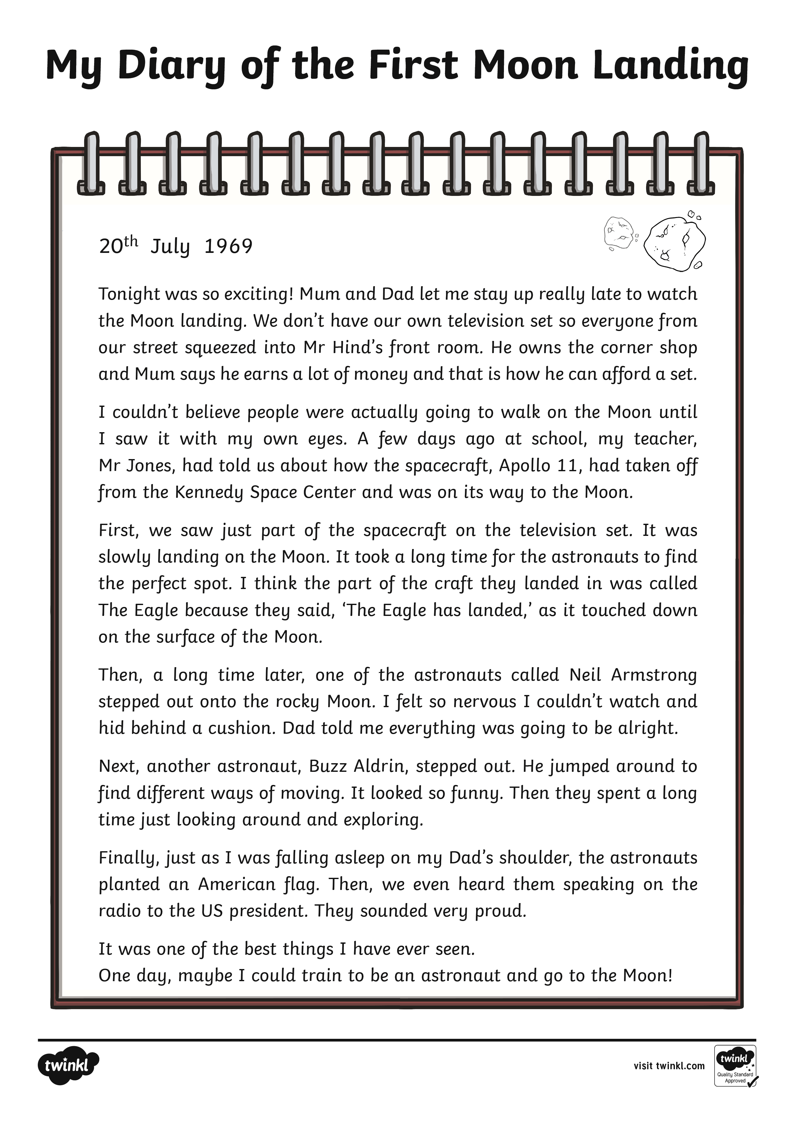

An Example Diary Entry
What do you need to include in a diary entry?
Take a look at this example to give you some ideas.
Scroll Down

Slide 14
An Example Diary Entry (Annotated)
What do you need to include in a diary entry?
Write as if you were there at the time.
Date
Use words:
I, my, we, our.
Write the most important events in order.
Scroll Down

Slide 15
An Example Diary Entry (Annotated)
What do you need to include in a diary entry?
Talk about where the events happened.
Use linking words: first, then, next.
Describe how you felt.

Slide 16
Diary Writing Checklist
Can you remember all the things you need to do to write a diary entry?
Have you included… | Tick
the date and perhaps the time?
some of the words: I, my, we, our?
the most important events in order?
where the events happened?
detail about the events as if you were there at the time?
how you felt?
some linking words: first, next, then?
Use this checklist to help you write your own diary entry.

Slide 17
Sharing Success
Who would like to share their diary entry with the class?
What have they done really well?
Have they included… | Tick
the date and perhaps the time?
some of the words: I, my, we, our?
the most important events in order?
where the events happened?
detail about the events as if you were there at the time?
how you felt?
some linking words: first, next, then?
Have they managed to include features from the checklist?

