Slide 1


Language Conventions
Capital Letter for the Personal Pronoun ‘I’
Year One
English | Year 1 | Language Conventions | Capital Letter for the Personal Pronoun ‘I’

Slide 3
Capital Letter for the Personal Pronoun ‘I’
Introductory Activity
Independent Focused Activity
Review Activity
Consolidation Activity
Assessment

Slide 4
Aim
I can use a capital letter for the personal pronoun ‘I’.
Success Criteria
I can use a capital letter for ‘I’ when I am writing about myself.

Slide 5
Introductory Activity

Slide 6







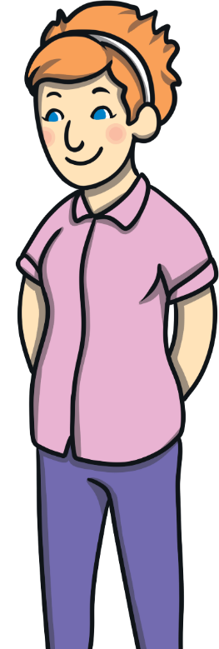
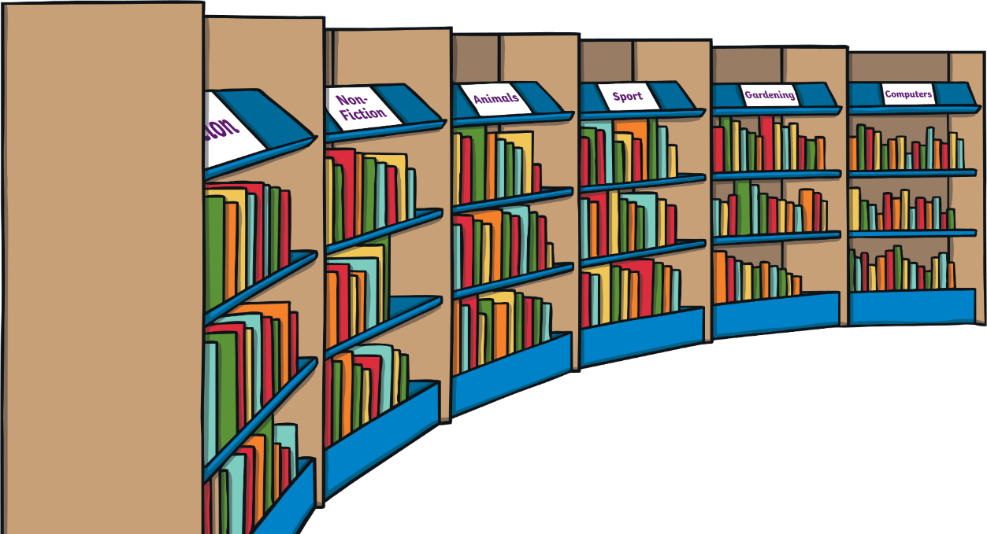
Capital Letter for ‘I’
Read this sentence aloud.
I am the teacher and I like books.

Slide 7
Capital Letter for ‘I’
Read the sentence again. Does it make sense? Why not?
i am the teacher and i like books.

Slide 8
Independent Focused Activity

Slide 9

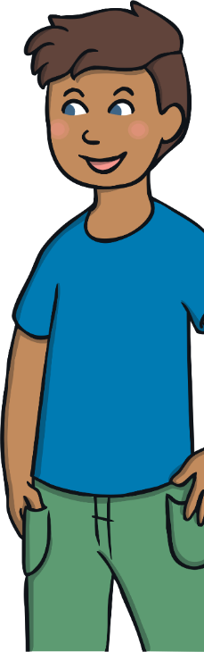
Composing a Sentence
Remember: A capital letter is needed for the word ‘I’.
Look at this boy. He is going to tell you about his t-shirt.
What could he say? Use the word ‘I’ to start your sentence.
Now, complete the first question on the activity sheet, using ‘I’ in your sentences.
Remember to check your work for full stops and capital letters!
I have a blue t-shirt

Slide 10
Review Activity

Slide 11
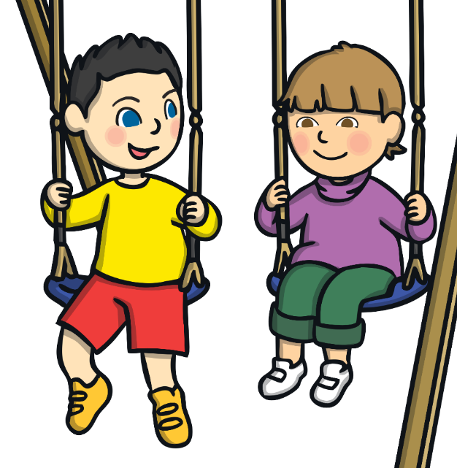
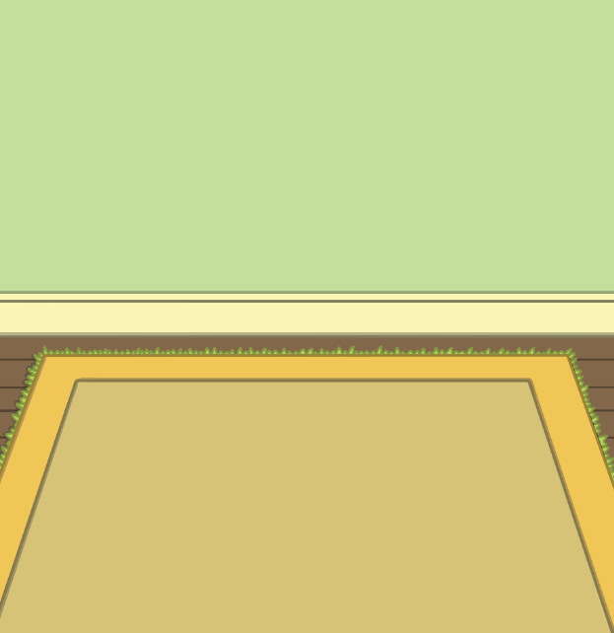


Capital Letters for the
Personal Pronoun ‘I’
Read these sentences aloud. What have I forgotten to do?
On Friday, i went to the park and i went on the swings.
When i got home, i sat down and I read a book.
I
I
I
I
I

Slide 12
Consolidation Activity

Slide 13
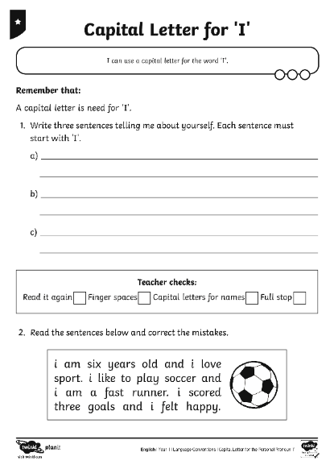
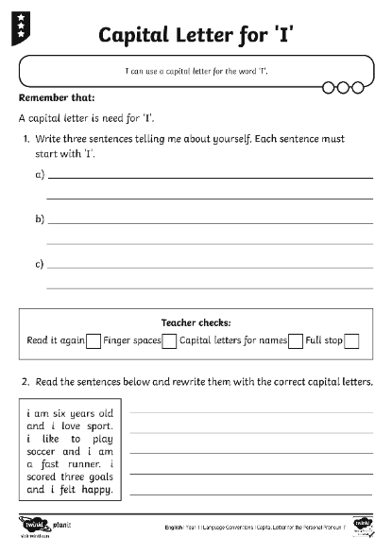




Editing Text
Remember: When you are talking about yourself, ‘I’ needs to be a capital letter.
Now, work on your own to complete question 2 on the Capital Letter for ‘I’ Activity Sheet.

Slide 14
Assessment

Slide 15
Capital Letter for ‘I’
Here are the questions that I want you to answer – turn to your partner and tell them the full sentence. Your partner must listen very carefully to make sure that you started your sentence with ‘I’.
You need to write in full sentences to answer each of the questions.
Remember to use a capital letter for the word ‘I’ when you are talking about yourself.
How old are you?
What do you like to eat?
What did you do at the weekend?
What colour hair do you have?
Now, work on your own to complete the Personal Pronoun Application Sheet.
When you have finished, read your sentences aloud to make sure that they make sense.

Slide 16
Aim
I can use a capital letter for the personal pronoun ‘I’.
Success Criteria
I can use a capital letter for ‘I’ when I am writing about myself.

