Slide 1



LIFE/work balance
We have started a #LIFEworkbalance campaign and we need your help to complete our LIFE/work balance survey.
We hope to publish the results soon, so please give 15 minutes of your time to help us get a true picture of school life.
Want to be a part of this campaign? Take the survey on our website and share it with your colleagues!
© Classroom Secrets Limited 2019

Slide 2
Year 2 – Autumn Block 2 – Addition and Subtraction – Bonds to 100 – Tens
About This Resource:
This PowerPoint has been designed to support your teaching of this small step. It includes a starter activity and an example of each question from the Varied Fluency and Reasoning and Problem Solving resources also provided in this pack. You can choose to work through all examples provided or a selection of them depending on the needs of your class.
National Curriculum Objectives:
Mathematics Year 2: (2C1) Recall and use addition and subtraction facts to 20 fluently, and derive and use related facts up to 100
More Year 2 Addition and Subtraction resources.
Did you like this resource? Don’t forget to review it on our website.
© Classroom Secrets Limited 2018

Slide 3
Year 2 – Autumn Block 2 – Addition and Subtraction
Step 5: Bonds to 100 – Tens
© Classroom Secrets Limited 2018

Slide 4
Introduction
Which ten frame represents 30 + 70 = 100?
A | ● | ● | ● | ● | ●
 | ● | ● | ● | ● | ●
B | ● | ● | ● | ● | ●
 | ● | ● | ● | ● | ●
C | ● | ● | ● | ● | ●
 | ● | ● | ● | ● | ●
© Classroom Secrets Limited 2018

Slide 5
Introduction
Which ten frame represents 30 + 70 = 100?
A | ● | ● | ● | ● | ●
 | ● | ● | ● | ● | ●
B | ● | ● | ● | ● | ●
 | ● | ● | ● | ● | ●
C | ● | ● | ● | ● | ●
 | ● | ● | ● | ● | ●
© Classroom Secrets Limited 2018

Slide 6
Varied Fluency 1
Use the ten frame to complete the number sentences below.
A. | 7 | + |  | = | 8
B. |  | + | 10 | = | 80
© Classroom Secrets Limited 2018

Slide 7
Varied Fluency 1
Use the ten frame to complete the number sentences below.
A. | 7 | + | 1 | = | 8
B. | 70 | + | 10 | = | 80
© Classroom Secrets Limited 2018

Slide 8
Varied Fluency 2
Match each number to its bond to 80.
10 |  | 30
50 |  | 20
60 |  | 70
© Classroom Secrets Limited 2018

Slide 9
Varied Fluency 2
Match each number to its bond to 80.
10 |  | 30
50 |  | 20
60 |  | 70
© Classroom Secrets Limited 2018

Slide 10
Varied Fluency 3
Complete the part whole model below in words.
one hundred
40
© Classroom Secrets Limited 2018

Slide 11
Varied Fluency 3
Complete the part whole model below in words.
one hundred
40
sixty
© Classroom Secrets Limited 2018

Slide 12
Problem Solving 1
Arrange the cards below to create a number sentence.
Find all the possibilities.
80
=
20
+
100
–
© Classroom Secrets Limited 2018

Slide 13
Problem Solving 1
Arrange the cards below to create a number sentence.
Find all the possibilities.
80 + 20 = 100 20 + 80 = 100 100 – 20 = 80 100 – 80 = 20
100 = 80 + 20 100 = 20 + 80 20 = 100 – 80 80 = 100 – 20
80
=
20
+
100
–
© Classroom Secrets Limited 2018

Slide 14
Reasoning 1
Circle the incorrect number sentence below.
Explain why it is incorrect.
A. | 20 | + | fifty | = | eighty
B. | fifty | + | thirty | = | 80
C. | eighty | = | 40 | + | forty
© Classroom Secrets Limited 2018

Slide 15
Reasoning 1
Circle the incorrect number sentence below.
Explain why it is incorrect.
A is incorrect because…
A. | 20 | + | fifty | = | eighty
B. | fifty | + | thirty | = | 80
C. | eighty | = | 40 | + | forty
© Classroom Secrets Limited 2018

Slide 16
Reasoning 1
Circle the incorrect number sentence below.
Explain why it is incorrect.
A is incorrect because 20 + fifty = seventy, not eighty as the number sentence states.
A. | 20 | + | fifty | = | eighty
B. | fifty | + | thirty | = | 80
C. | eighty | = | 40 | + | forty
© Classroom Secrets Limited 2018

Slide 17
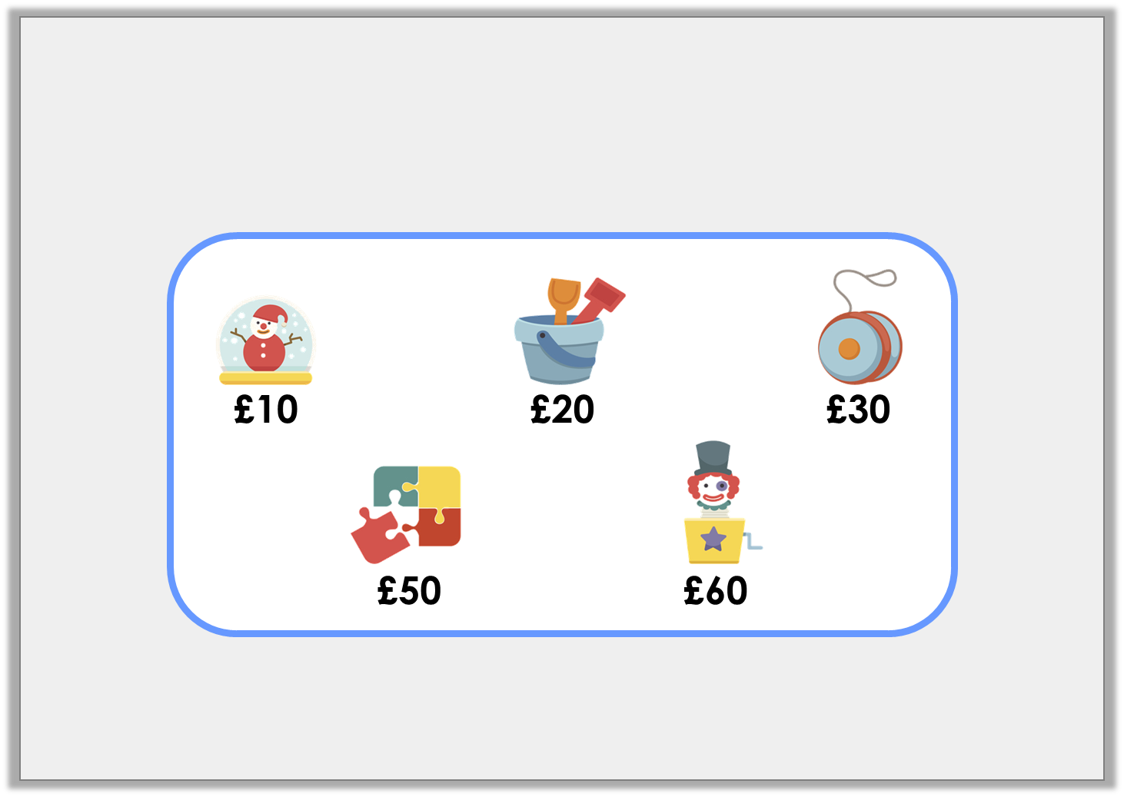
Problem Solving 2
Kumar spends £80 on two items. Which items did he buy?
Find all the possible combinations.
© Classroom Secrets Limited 2018

Slide 18
Problem Solving 2
Kumar spends £80 on two items. Which items did he buy?
Find all the possible combinations.
Bucket and Jack-in-the-Box;
yo-yo and jigsaw
© Classroom Secrets Limited 2018

