Slide 1
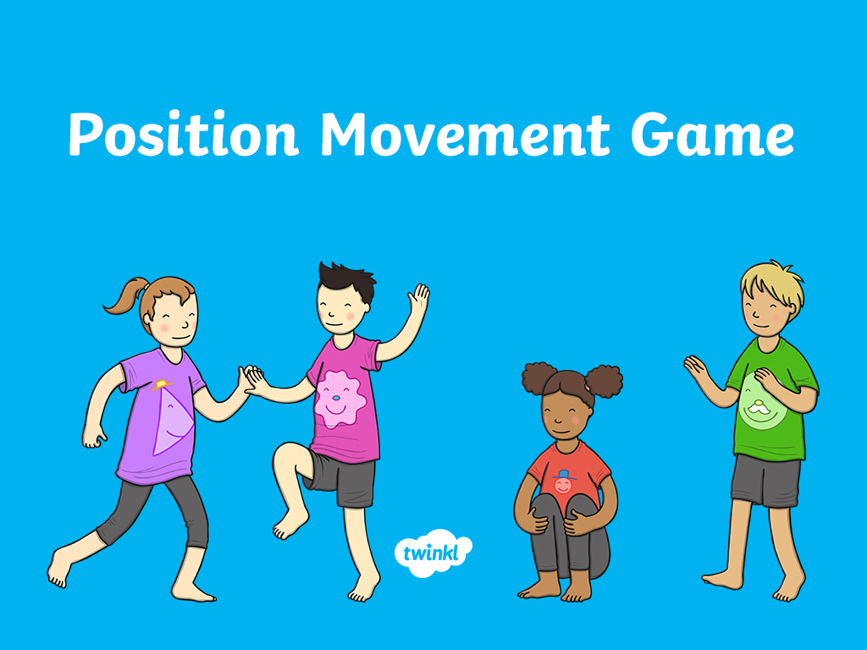

Slide 2
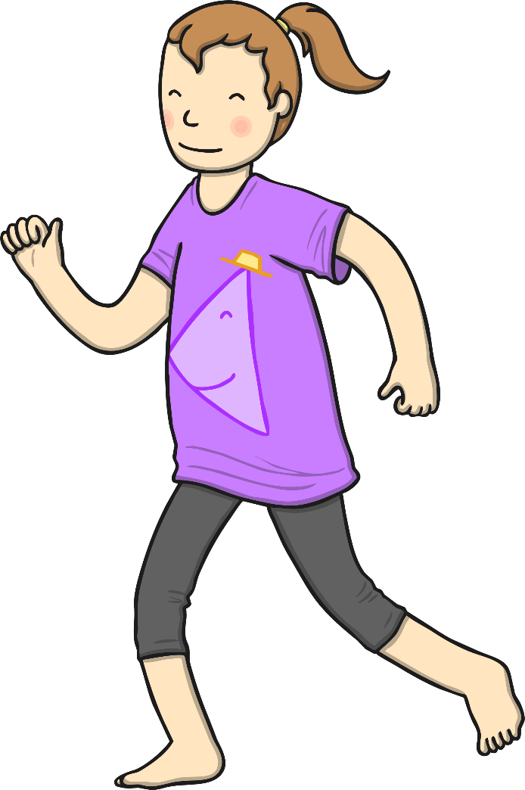
Jump to the left.

Slide 3
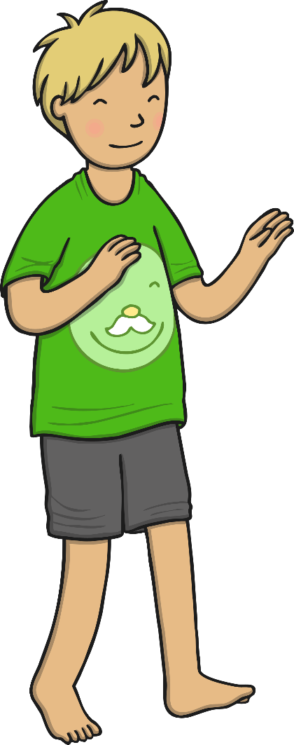
Slide to the right.

Slide 4
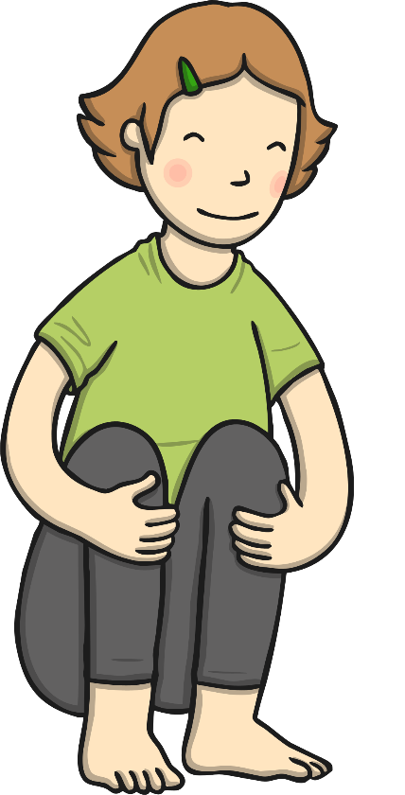
Squat down low.

Slide 5
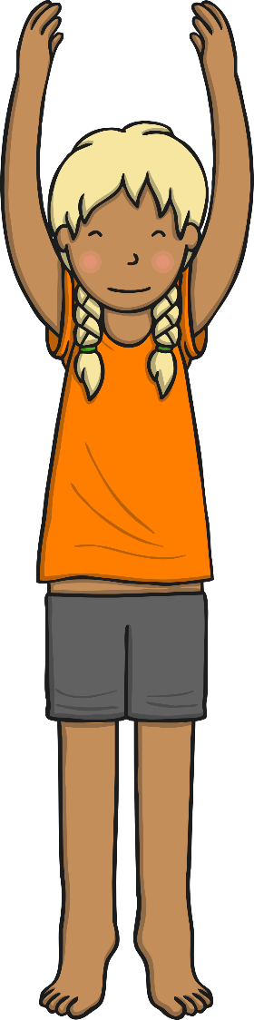
Reach high above your head.

Slide 6
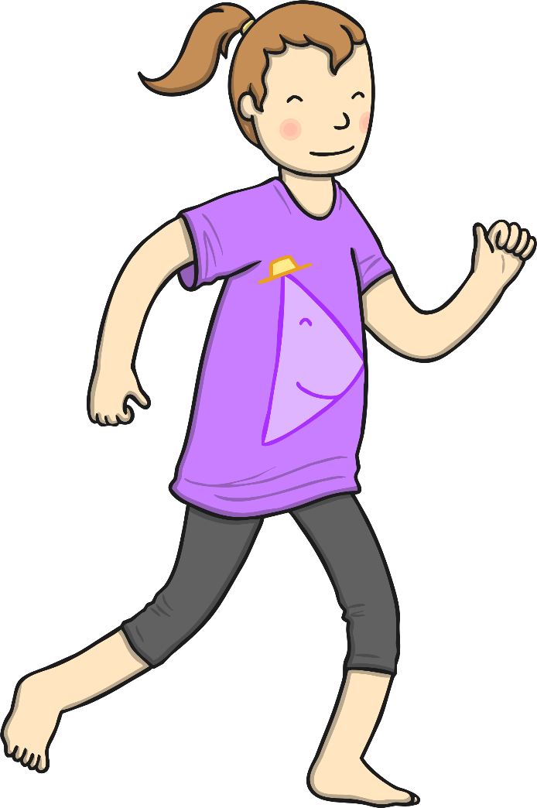
Jump to the right.

Slide 7
Jump to the left.

Slide 8
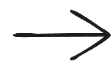
Slide towards the front.

Slide 9
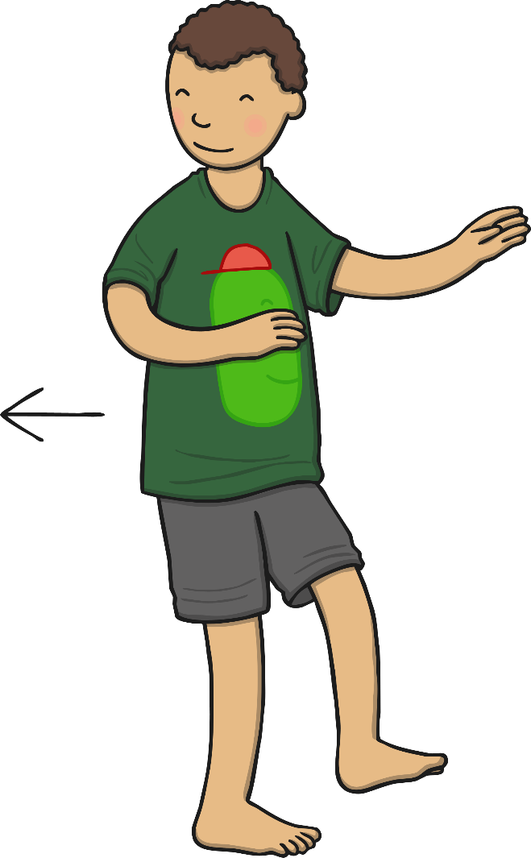
Slide towards the back.

Slide 10
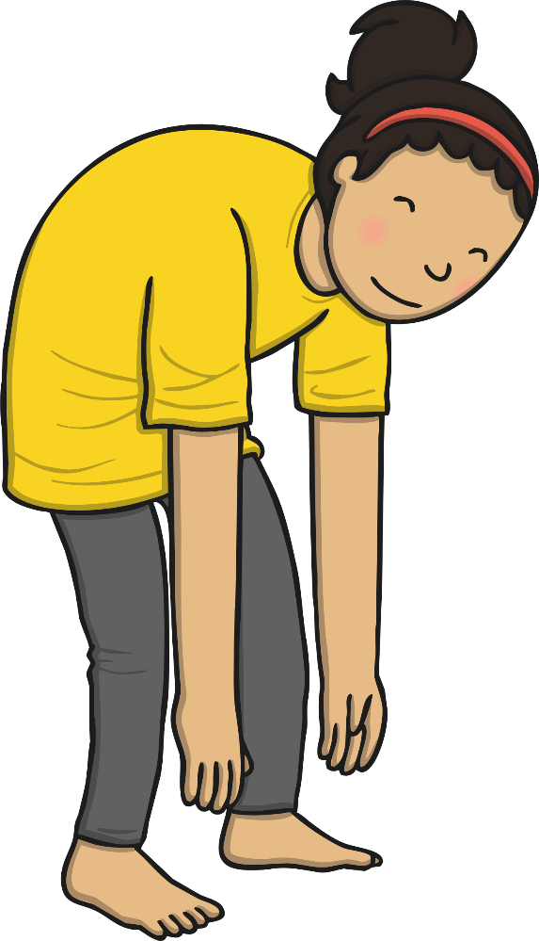
Bend down and touch the ground.

Slide 11

Point up to the ceiling.

Slide 12
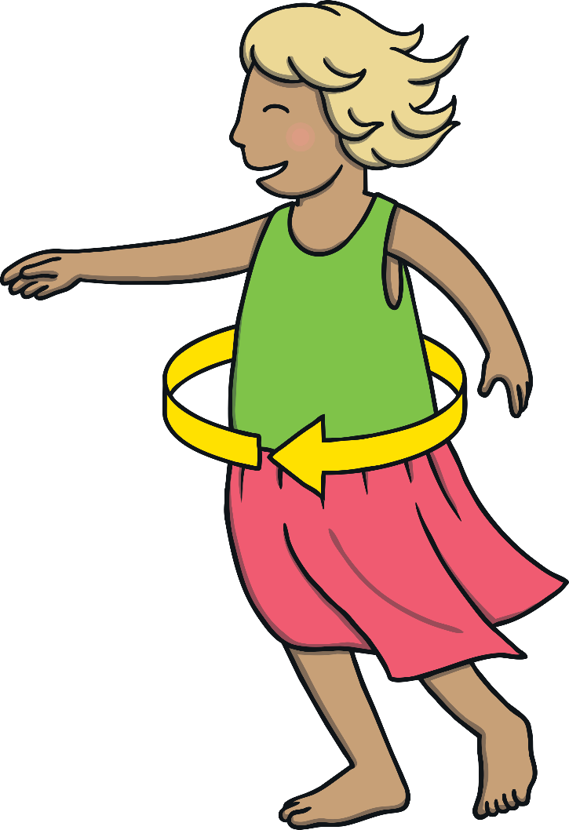
Turn around on the spot.

Slide 13

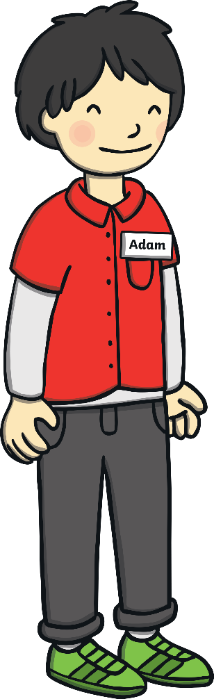
Stand next to a friend.

Slide 14
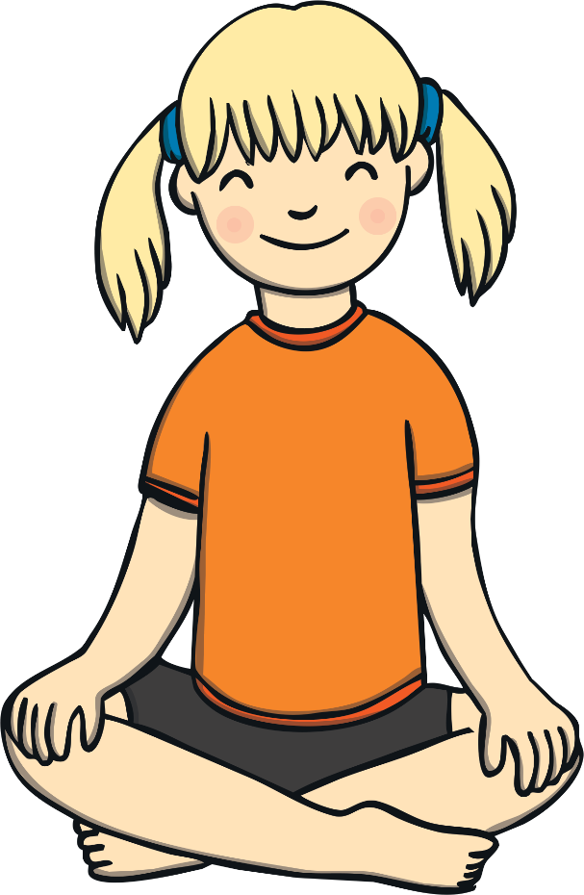
Sit down on the floor.

Slide 15


