Slide 1


Maths
Measurement
Year One
Maths | Year 2 | Measurement | Telling the Time | Lesson 2 of 4: Dinner Time at Dinosaur Park

Slide 3
Aim
To draw clock hands to show quarter past and quarter to the hour times.
Success Criteria
I can read quarter past and quarter to times on a clock.
I can draw a long hand to represent the minutes and a short hand to represent the hour.
I can draw the hands on a clock, using the correct hand for the minutes and hour.

Slide 4

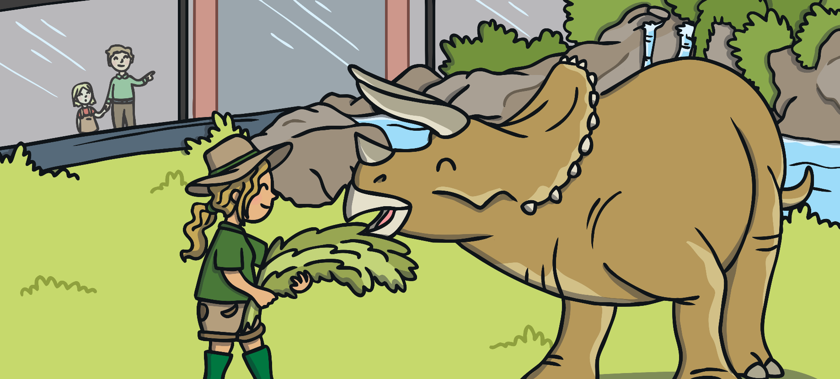
Feeding Time!
It’s feeding time at Dinosaur Park.
?
Can you work out which dinosaur she needs to feed next?

Slide 5
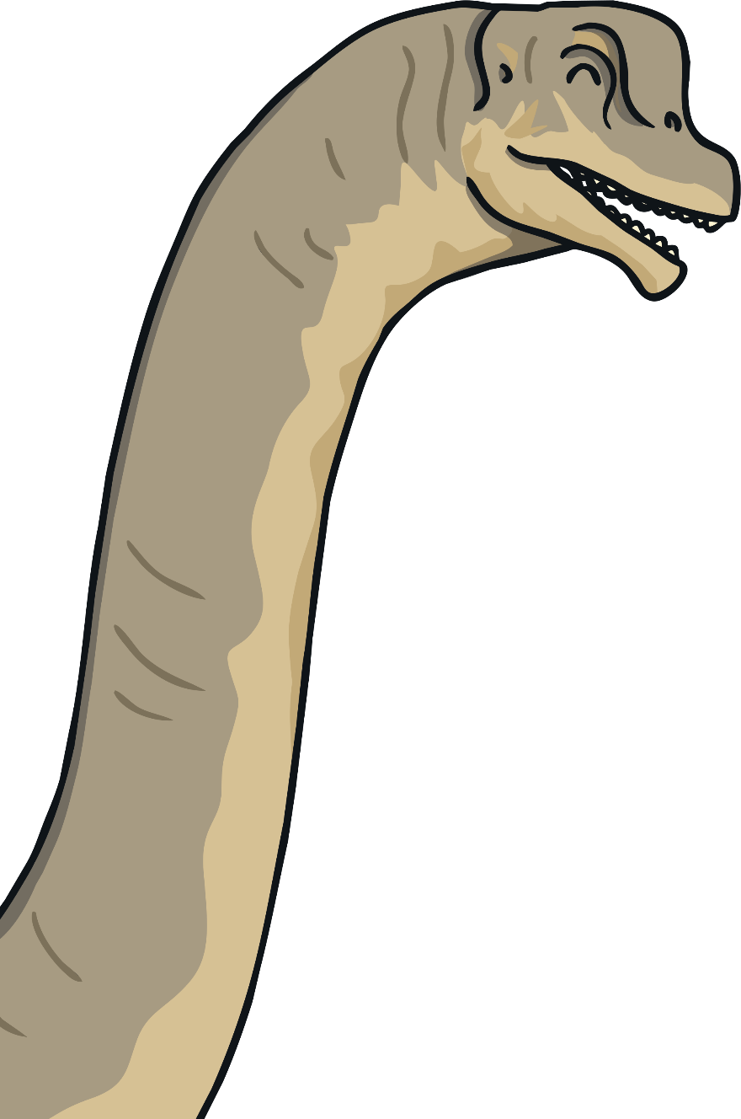
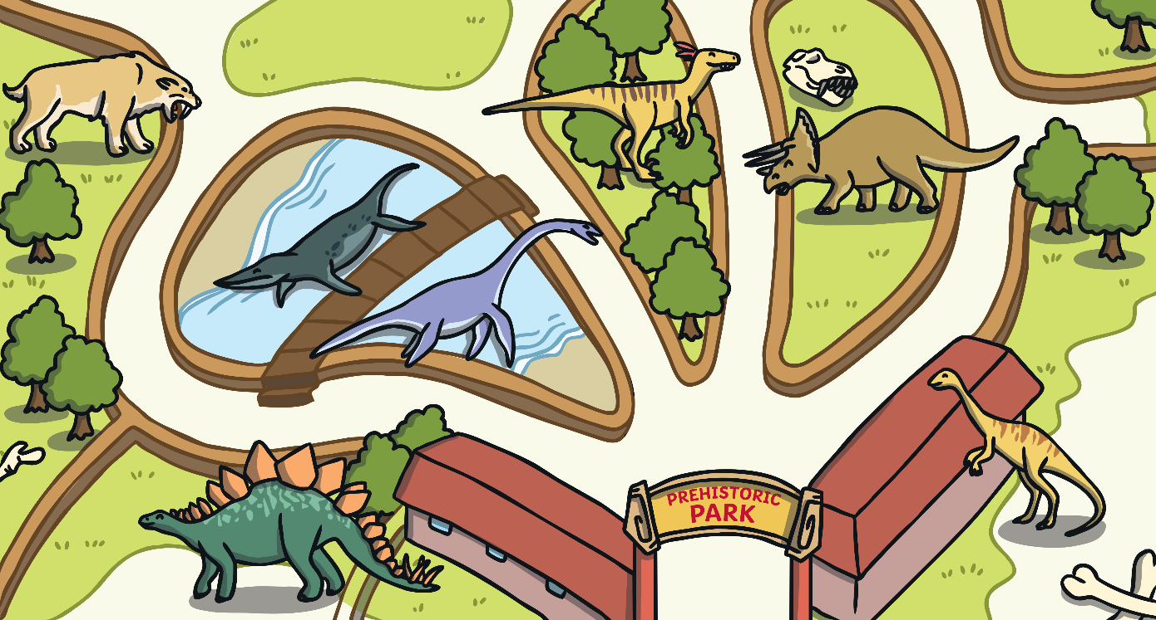
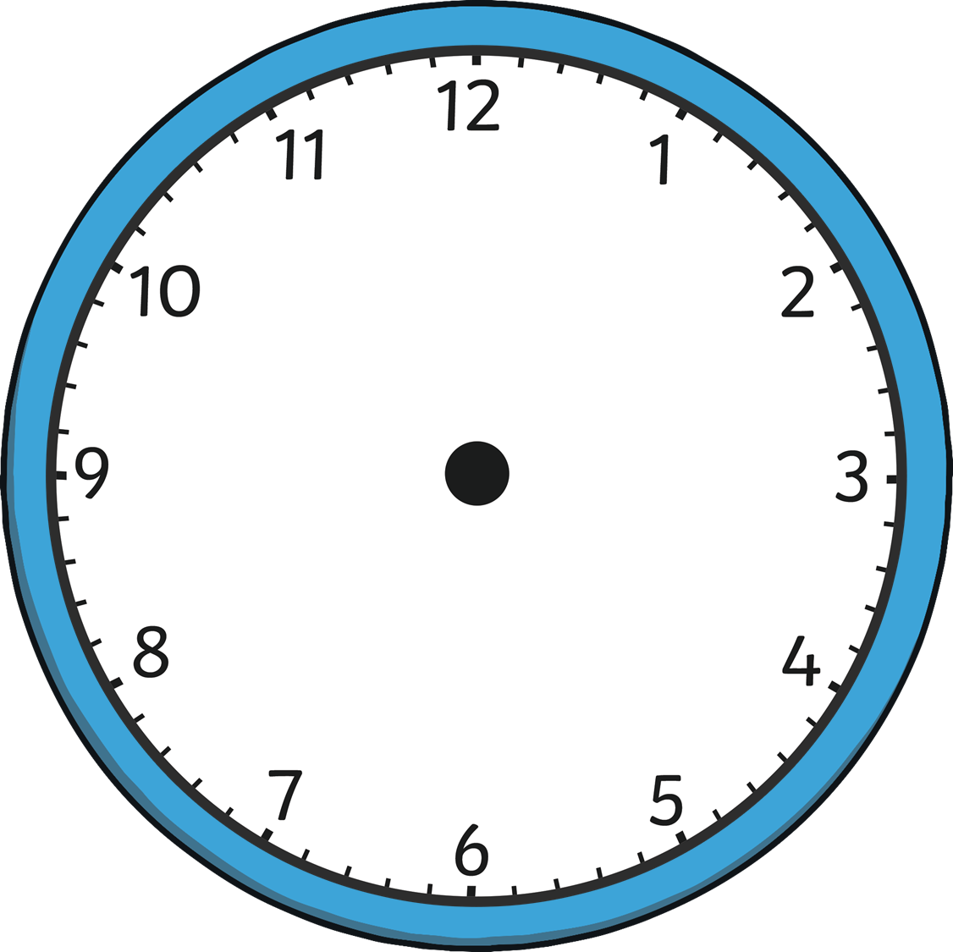
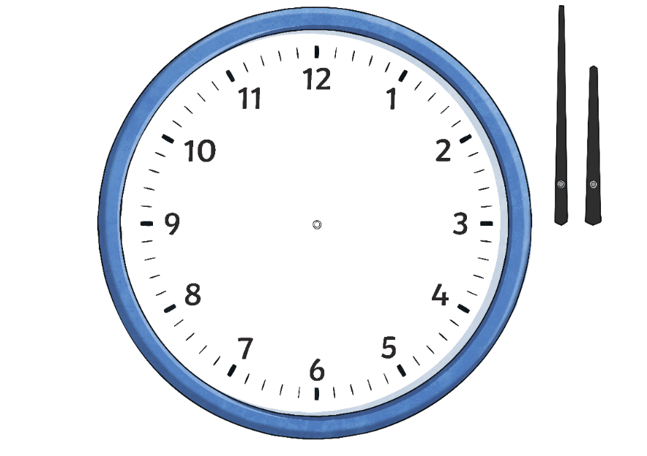
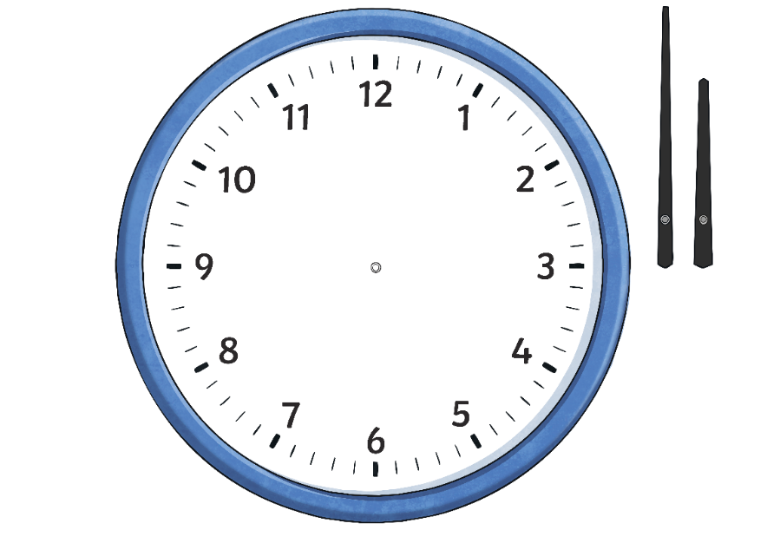
Feeding Time!
Click the correct time.
Well done!
half past 8
quarter past 8
quarter to 9

Slide 6
Feeding Time!
Click the correct time.
Well done!
quarter past 3
quarter past 10
quarter to 3

Slide 7
Feeding Time!
Click the correct time.
Well done!
quarter past 12
7 o’clock
3 o’clock

Slide 8
Feeding Time!
Click the correct time.
Well done!
quarter past 9
quarter to 4
half past 6

Slide 9
Feeding Time!
Click the correct time.
Well done!
quarter past 12
1 o’clock
3 o’clock

Slide 10
Feeding Time!
Click the correct time.
Well done!
quarter to 4
quarter to 5
quarter past 4

Slide 11
Feeding Time!
Click the correct time.
Well done!
quarter to 10
half past 10
half past 9

Slide 12
Feeding Time!
Click the correct time.
Well done!
9 o’clock
quarter to 9
quarter to 12

Slide 13

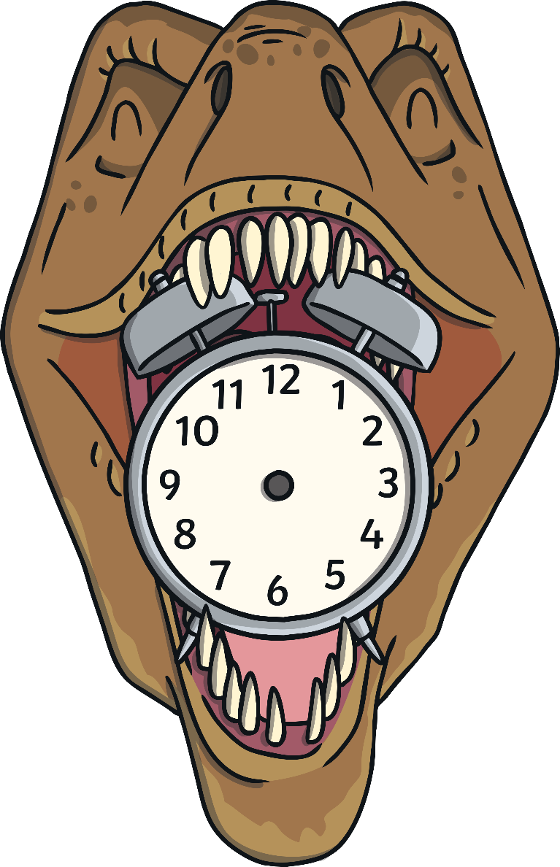
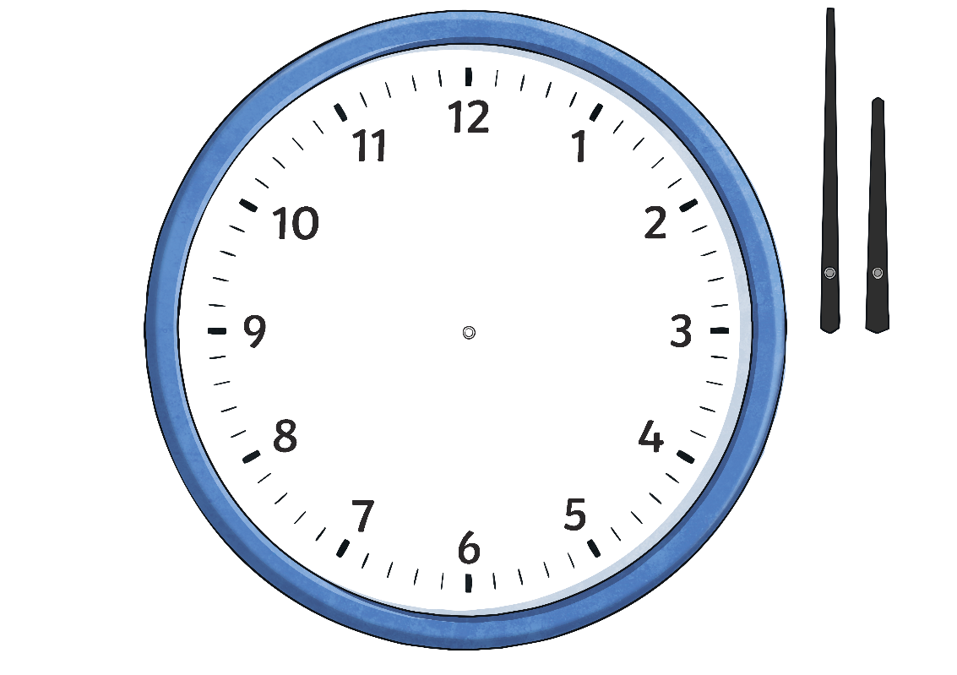

Watch Your Hands!
The small hand on a clock tells us what hour it is. We call this the hour hand.
hour hand

Slide 14
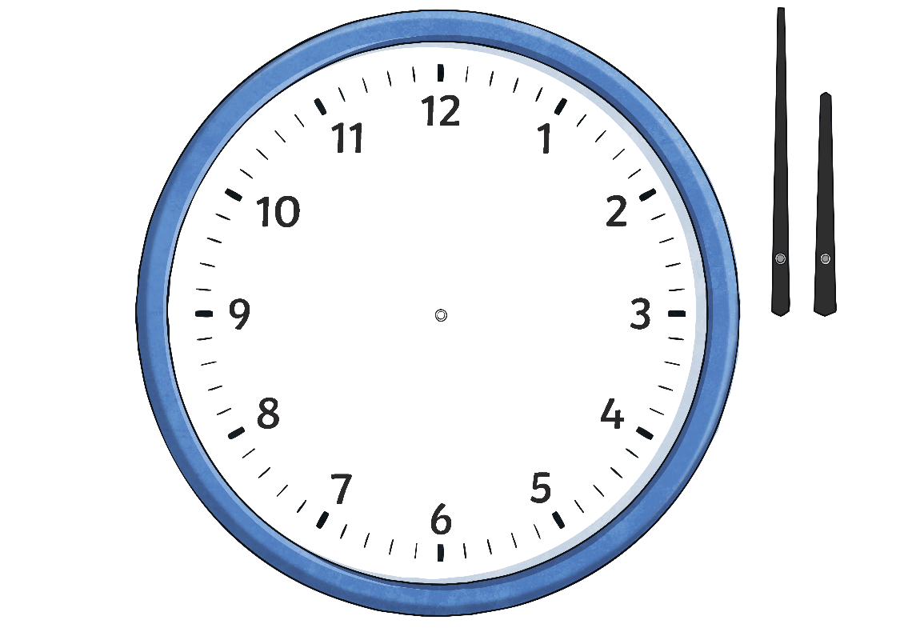
Watch Your Hands!
The big hand on a clock tells us what minute it is. We call this the minute hand.
hour hand
minute hand

Slide 15
Watch Your Hands!
If I want to show half past 3 then I need to remember which is the hour hand and which is the minute hand.
Can you remember? Click to check!
?
hour hand
?
minute hand

Slide 16

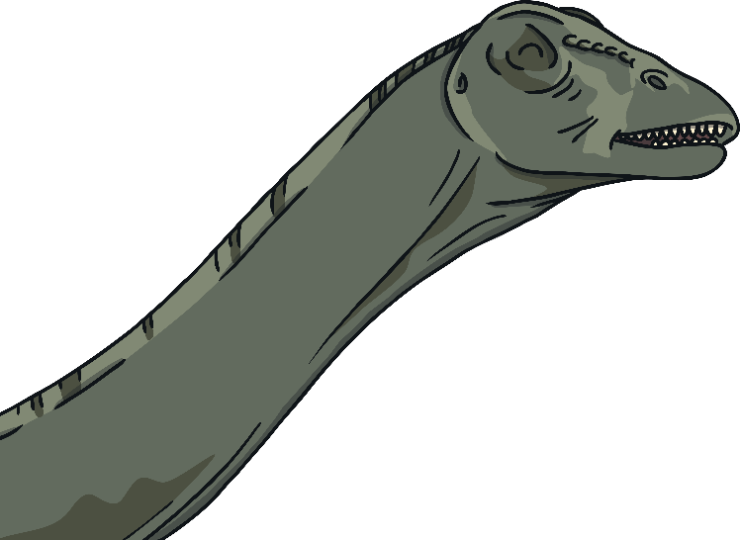
Watch Your Hands!
Half past 3 means the minute hand has travelled halfway around the clock face.

Slide 17
Watch Your Hands!
We can use a long hand to show the minutes. The minute hand starts at the centre point and points down towards the 6.

Slide 18
Watch Your Hands!
Remember, the hour hand should be shorter than the minute hand.’
It is half past 3 so the hour hand is halfway past the 3.
The clock shows a half past time but we need to draw in the hour.
I can draw a short hand to show the hour.

Slide 19
Watch Your Hands!
?
Can you work out what times are being drawn on these clocks?
6 o’clock

Slide 20
Watch Your Hands!
?
Can you work out what times are being drawn on these clocks?
quarter to 7

Slide 21
Watch Your Hands!
?
Can you work out what times are being drawn on these clocks?
quarter past 12

Slide 22

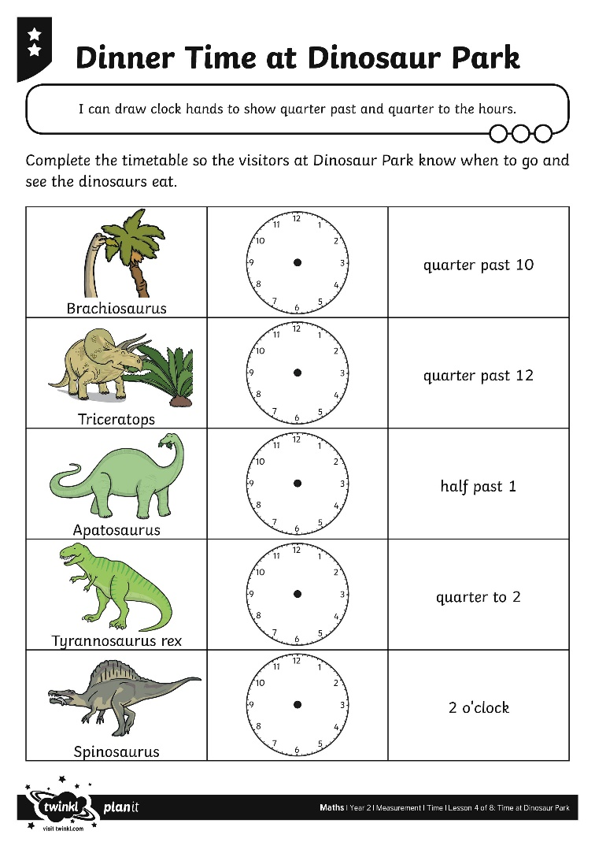
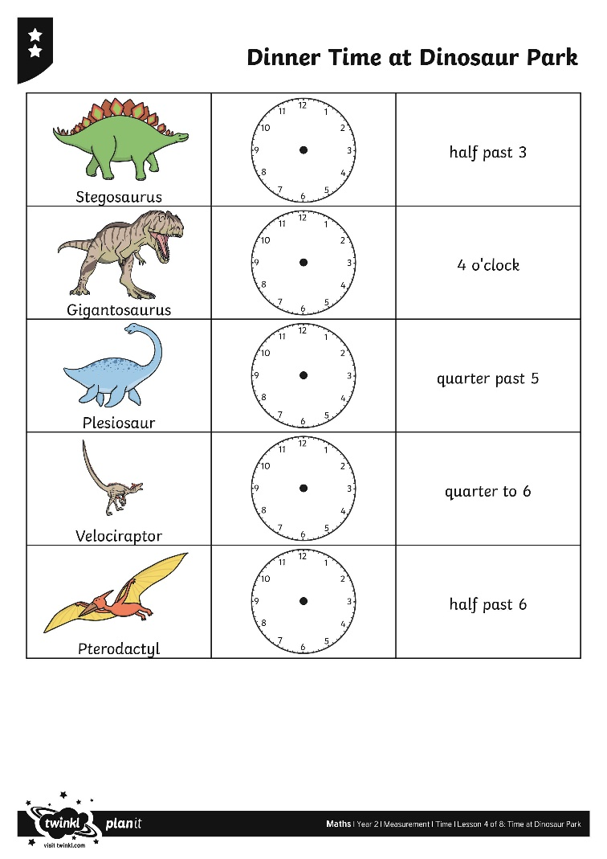
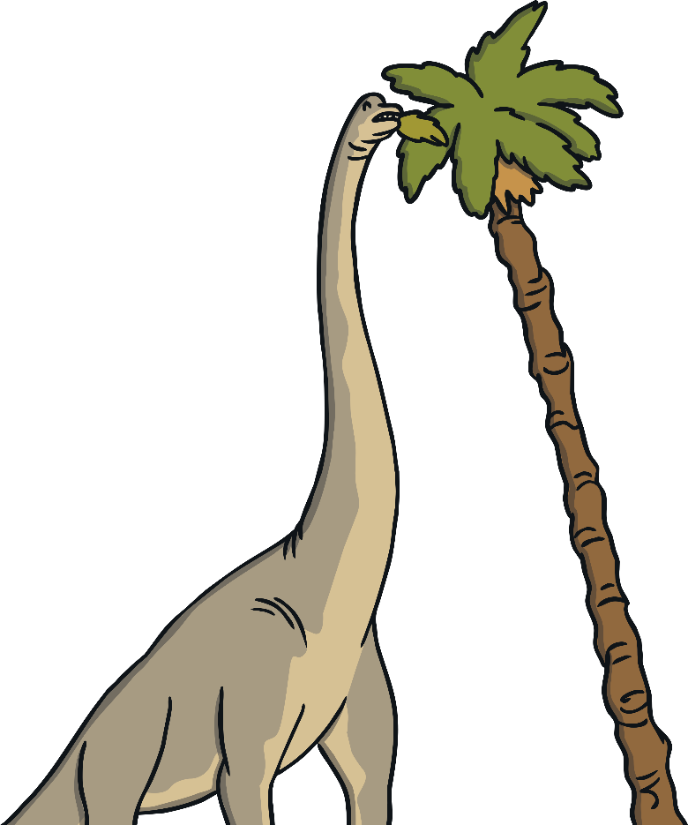
Dinner Time at Dinosaur Park

Slide 23
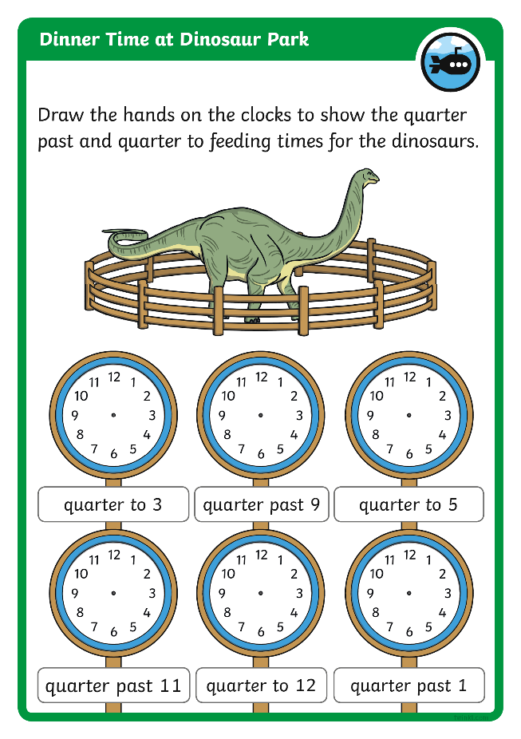
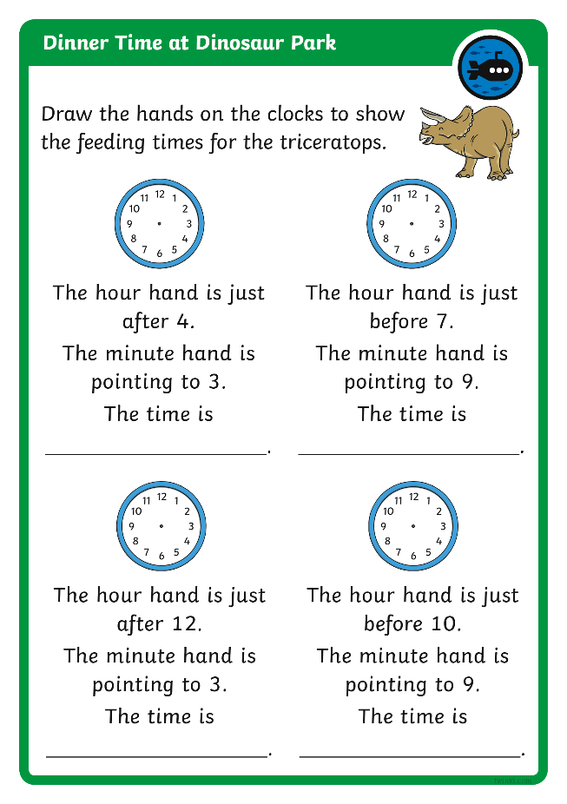

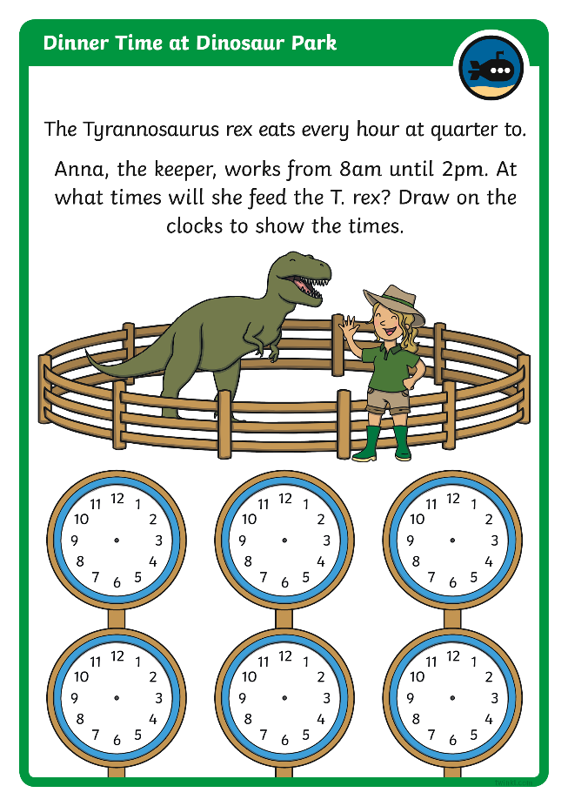
Diving into Mastery
Dive in by completing your own activity!

Slide 24
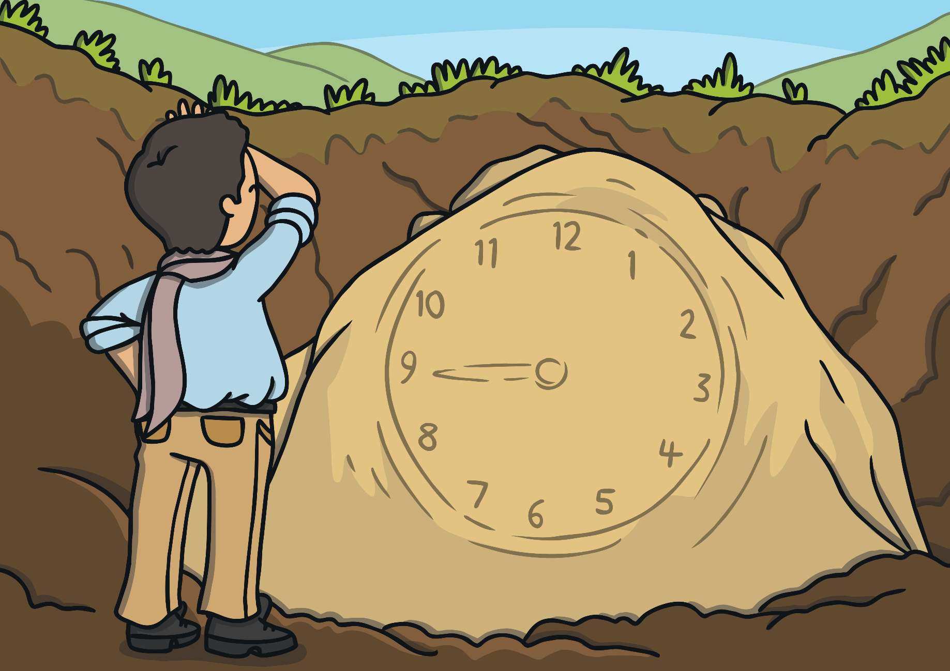
Clock Rocks
An archaeologist has discovered this clock face carved into the rock. One of the clock hands has been worn away but we don’t know which. Its exact time cannot be certain.

Slide 25
Clock Rocks
?
Which of these times could not be the time. Can you explain why?
9 o’clock
half past 9
quarter to 9
quarter to 4

Slide 26

Aim
To draw clock hands to show quarter past and quarter to the hour times.
Success Criteria
I can read quarter past and quarter to times on a clock.
I can draw a long hand to represent the minutes and a short hand to represent the hour.
I can draw the hands on a clock, using the correct hand for the minutes and hour.

